Slide 1
Lesson 2
Taking Responsibility for Your Health
Part 1: Building Health Skills
Part 2: Being a Wise Health Consumer

Slide 2
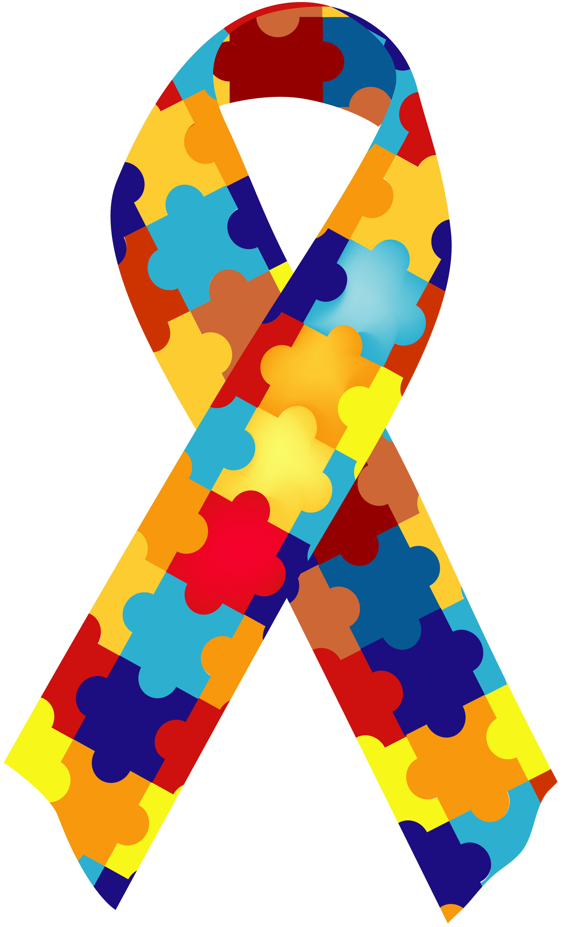
A Healthy You
Meeting your personal health goal:
Step 1: Gaining Awareness
Step 2: Gaining Knowledge
Step 3: Building Health Skills
Health Skills: Specific tools and strategies to maintain, protect, and improve all aspects of your health. Also called “life skills.”
Notes:
Gaining awareness – you must first be able to recognize a health problem before you can do anything about it. Easy to recognize problem (having cold, twist ankle). Others, high blood pressure (no obvious sign) – see doctor for annual checkup. Doctors are trained to recognize the early signs of diseases
Gaining knowledge – once you become aware of the health problem, the next step is to learn about the problem (cause, warning sign, and possible outcomes, prevention, treatment, risk factors (related to behavior). Some source of information are more reliable than others.
Building health skills – knowledge isn’t very useful if you do not have the skills to apply it.

Slide 3
Health Skills
The Health Skills
Analyzing Influences
Accessing Information
Communication
Advocacy
Making Decision
Goal Setting
Practicing Healthful Behaviors

Slide 4
#1 – Analyzing Influences
“Why do you do the things you do?”
What affects your health…?
The Health Skills
Analyzing Influences
Accessing Information
Communication
Advocacy
Making Decision
Goal Setting
Practicing Healthful Behaviors
Notes:
How do you decide what foods to eat? Do you select certain foods because they are familiar from your culture? Does advertising affect your choices? Do you try foods if your friends like them? An important skill for promoting health is recognizing the influence culture, media, and friends have on your habits.

Slide 5
#2 – Accessing Information
Knowing how to find and evaluate health information
What sources of information about health-related products and services
can you trust?
The Health Skills
Analyzing Influences
Accessing Information
Communication
Advocacy
Type of Websites
Author of the site
Current
Quality
Verify with other sources
Making Decision
Goal Setting
Practicing Healthful Behaviors
Notes:
Health care providers & professionals
Recently published materials
Parents, guardians, and trusted adults
Valid internet site
Government agencies
Professional health organization

Slide 6
#3 – Communication
Communication is more than just talking
It is a combination of Interpersonal Communication, Refusal Skills, and Conflict Resolution.
The Health Skills
Analyzing Influences
Accessing Information
Communication
Advocacy
Making Decision
Goal Setting
Practicing Healthful Behaviors
Notes:
Interpersonal Communication- the exchange of thoughts, feelings and beliefs between two or more people. Helps build strong relationships with others.
Refusal Skills- communication strategies that can help you say no when you are urged to take part in behaviors that are unsafe or unhealthful, or go against your values.
Conflict Resolution- the process of ending a conflict through cooperation and problem solving.

Slide 7
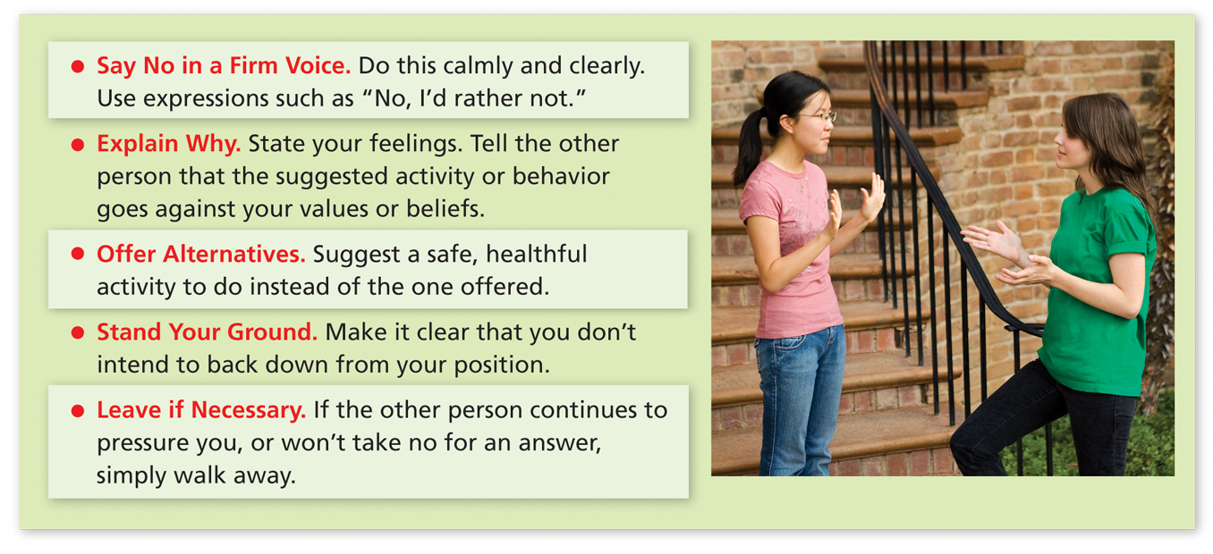
These refusal strategies can help you say no to potentially harmful activities.

Slide 8
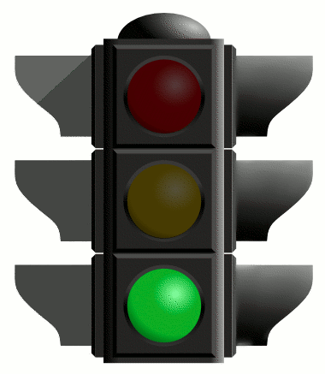
Refusal Skill Practice
60 Second Activity
STAND UP
Face the person across from you
What are other situations where you might be asked to do something against your values?

Slide 9
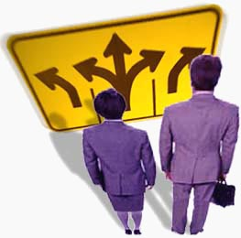
#4 – Making Decision
Values: ideas, standards, beliefs, and attitudes about what are most important to you
DECIDE process:
Define the problem
Explore the alternatives
Consider the consequences
Identify your values
Decide and act
Evaluate the results
Notes:
Making wise decision is key to protecting your health. The DECIDE process can help you make difficult decision. This process teach you to identify your alternatives, think about the possible out comes of a decision, and consider your values. You values are the standards and beliefs that are most important to you

Slide 10
#4 – Making Decision
DECIDE process
Notes:
We make decisions everyday. Some are small, some are life changing.

Slide 11
#5 – Goal Setting
Goals- those things you aim for that take planning and work. This is how we plan for the future and reach our potential.
Short-term goals- a goal you can reach in a short amount of time.
Finishing a paper by Friday, eating healthy this week, etc.
Long-term goals- a goal that you plan to reach over an extended period of time.
Examples: Graduate from HS, go to college, save $$ for a trip, etc.
Action Plan- A multistep strategy to identify and achieve your goals.
Notes:
The goals you set help you translate knowledge into behavior. Once your set goal, you can develop an action plan—a series of specific steps you can take to achieve the goal. The plan is like a roadmap that helps you get from where you are to where you want to go.

Slide 12
Making the Connection…

Slide 13
Create a New Path…

Slide 14
#6 – Practicing Healthful Behaviors
Develop strategies for maintaining healthy behaviors and reducing risk behavior.
Practice new behavior repeatedly until it becomes a habit.
The Health Skills
Analyzing Influences
Accessing Information
Communication
Advocacy
Making Decision
Goal Setting
Practicing Healthful Behaviors
Notes:
Do some of your current behaviors enhance your health?
Do others place your health at risks?

Slide 15
#7 – Advocacy
Using communication to influence and support others in making positive health decisions.
The Health Skills
Analyzing Influences
Accessing Information
Communication
Advocacy
Making Decision
Goal Setting
Practicing Healthful Behaviors
Notes:
Advocate – to speak or write in support of a person or issue

