Slide 1
Unit 3 Lesson 1 Chain of Infection
Ms. Sarina Promthong

Slide 2
Unit 3 Lesson Outline
Lesson 1 | Lesson 2 | Lesson 3 | Lesson 4 | Lesson 5
Agenda: Introduction to infectious disease Chain of Infection HW Chain of infection | Agenda: Virus vs. Bacteria Pathogen Card making HW Print out 30xpathogen card 10xcharacter card 30xantibiotic card 8X vaccination card | Agenda: Catching the fever trading card game! Common Viral & Bacterial Infections and Prevention | Agenda: Clinical epidemiology lab Role play: HCW (doctor) & patient | Agenda: Host defense Introduction to the final project Emerging, Reemerging Diseases PSA making

Slide 3
Cause of Communicable Diseases
Communicable diseases, also know as infectious diseases are caused by organisms or viruses that enter and multiply within the human body.
Microorganisms are organisms that can be seen only through a microscope.
Microorganisms and viruses that cause disease are called pathogens.
Pathogens can cause an infectious disease when they enter your body and multiply.

Slide 4
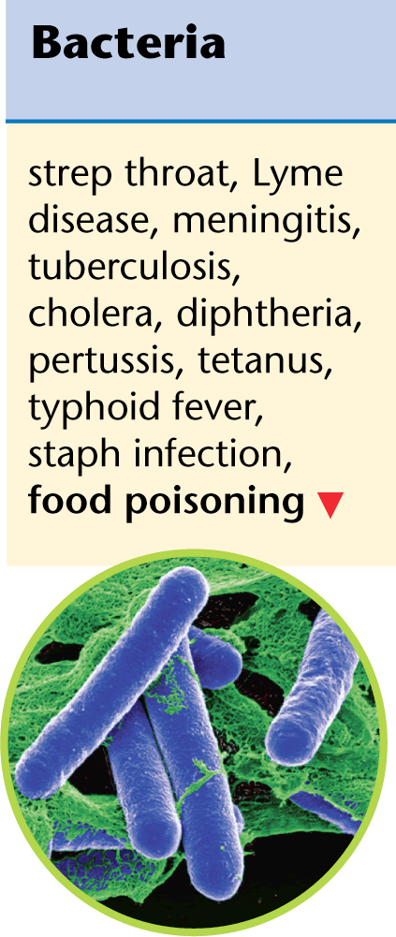
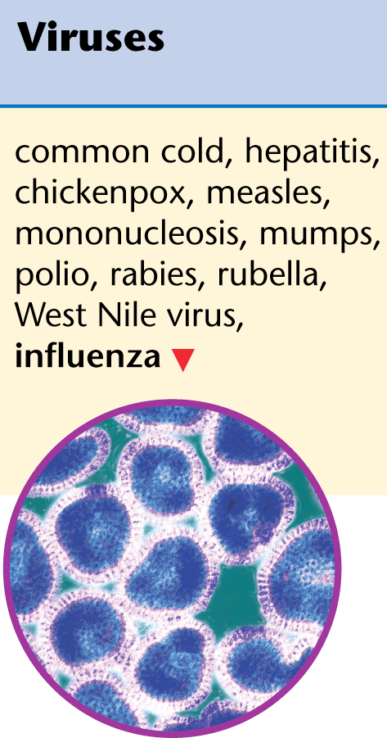
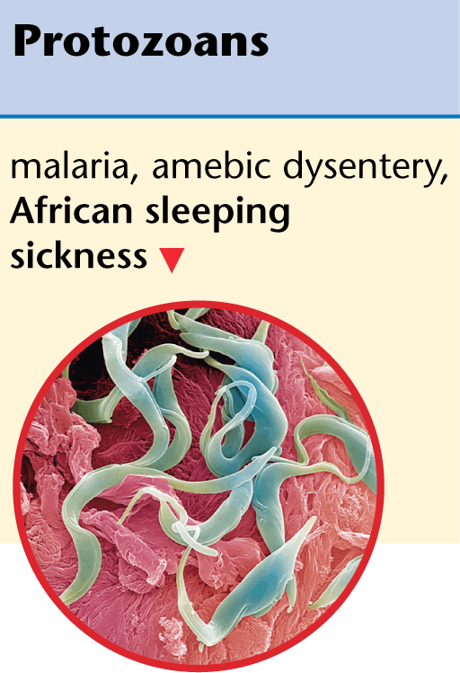
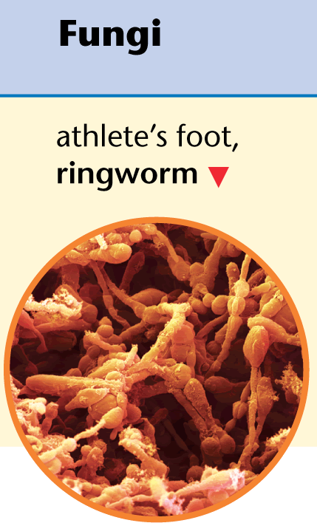
Types of Pathogen
Bacteria
Virus
Protozoans
Fungi
Notes:
Bacteria are simple, single-celled microorganisms. Bacteria live in air, soil, food, and in and on the bodies of plants and animals, including you.
Some bacteria injure cells by giving off poisons called toxins.
The smallest pathogens are viruses. A virus can multiply only after entering a living cell. The virus then takes over the cell’s reproductive mechanisms, resulting in cell damage or death.
Organisms such as yeasts, molds, and mushrooms are known as fungi (FUN jy). Fungi grow best in warm, dark, moist areas.
Single-celled organisms that are much larger and more complex than bacteria are known as protozoans (proh tuh ZOH unz). Protozoans have the ability to move through fluids in search of food.

Slide 5
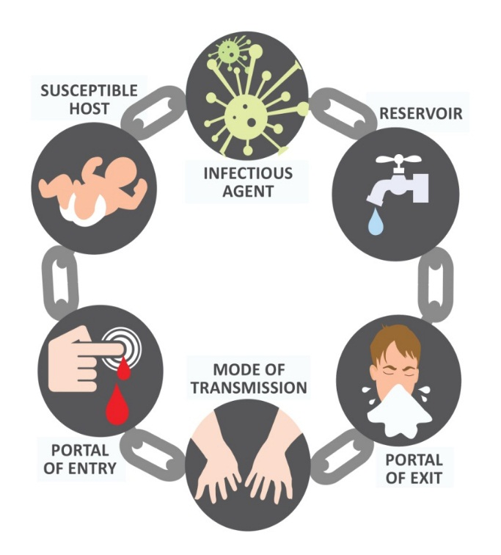
Chain of Infection Class Discussion
1. Infectious agents are microorganisms (or microbes) with the ability to cause infection. (e.g. Bacteria, Virus, etc.)
2. The 'reservoir' is where microbes live and where pathogens can survive, thrive and reproduce.
6. The individuals who got in infected
Low immune
Pathogen multiply in large number
5. An opening or ways allowing the pathogen to enter the host.
3. A place of exit providing a way for a pathogen to leave the reservoir.
4. The way in which the pathogen moves or is carried from one place to another.

Slide 6
Breaking the Chain of Infection
1. Infectious agent
preventative treatment – for those who may be exposed
rapid identification
prompt treatment – for those infected
good health and hygiene.
6. Susceptible host
treatment of primary disease
recognising high risk clients.
2. Reservoir
good health and hygiene
environmental sanitation
disinfection/sterilisation
hand hygiene.
5. Portal of entry
hand hygiene
wound care
catheter care
aseptic technique
3. Portal of exit
hand hygiene
control of excretions and secretions
proper attire
appropriate disposal of trash and waste.
4. Mode of transmission
hand hygiene, proper food handling, isolation procedures, airflow control, or disinfection/sterilisation

Slide 7
Unit 3 Lesson 2 BACTERIA vs. VIRUS
Ms. Sarina Promthong

Slide 8
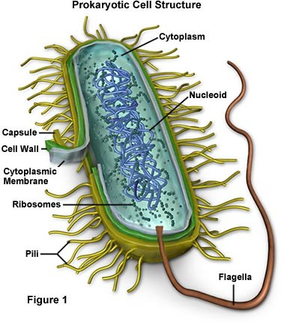
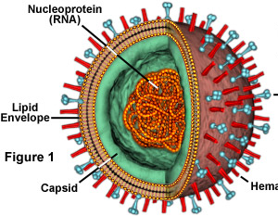
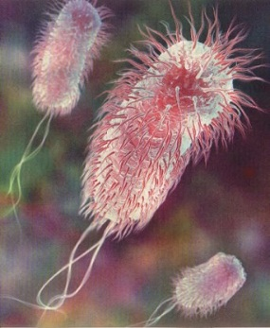
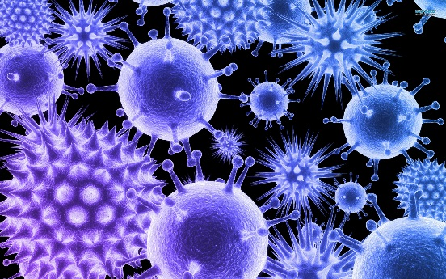
List as many details as possible about virus or bacteria from the pictures!
Virus or bacteria?
How do they reproduce?
Type of genetic material?
How big are they? (comparison to familiar object)
Figure 2
Figure 1

Slide 9
Virus VS. Bacteria
VIRUS | BACTERIA
Non-cellular structure, composed of… Nucleic acids (genetic material; either DNA or RNA) Capsid | Living, microscopic unicellular prokaryotic Lack of membrane-bound nucleus and membrane-bound organelles.
Nonliving (fail to meet criteria of life) Do not metabolize Do not reproduce Do not have properties of cell
Grouped according to properties as Size Nucleic acid Capsid and protein subunits Host Species Immunological characteristics | Five typical shapes Rod-shaped (bacillus) Round (coccus) Spiral (spirillum) Coccobacillus Vibrio

Slide 10
Virus VS. Bacteria (1. Structure and Size)

Slide 11
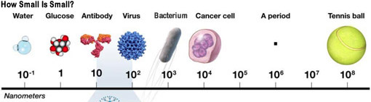
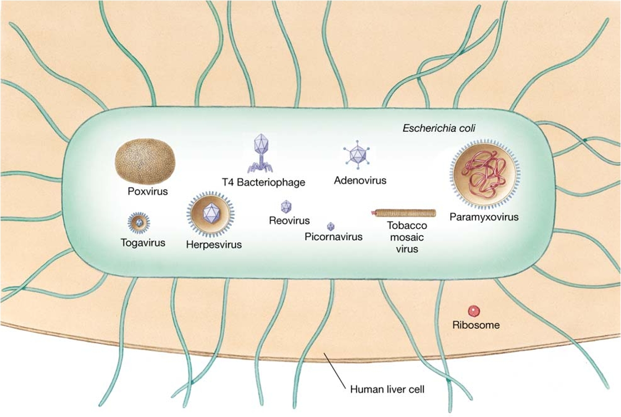
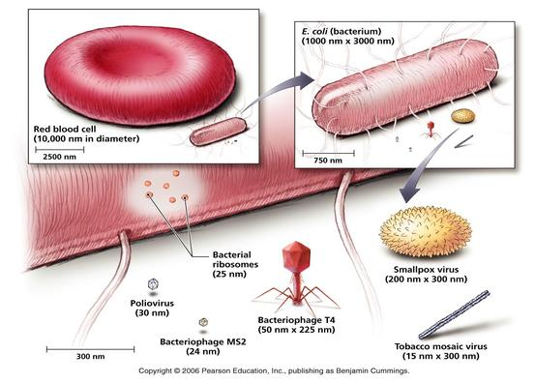
Comparing the Sizes

Slide 12
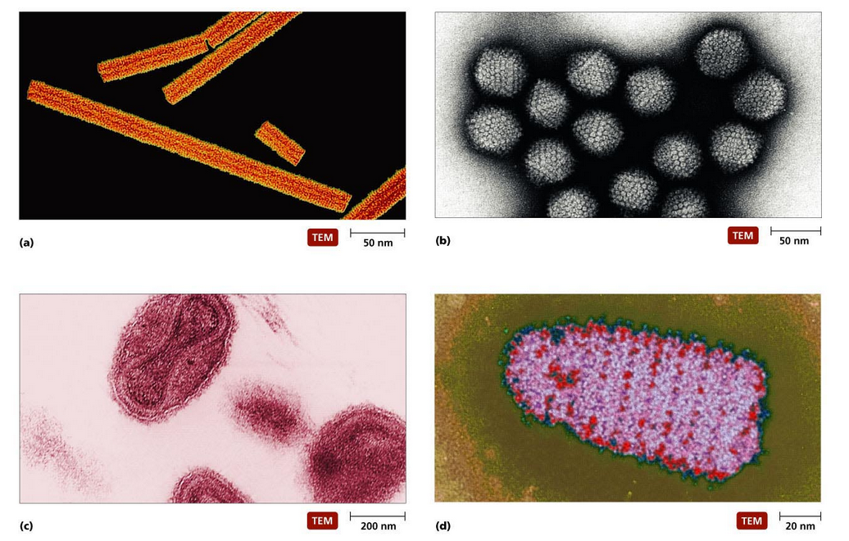
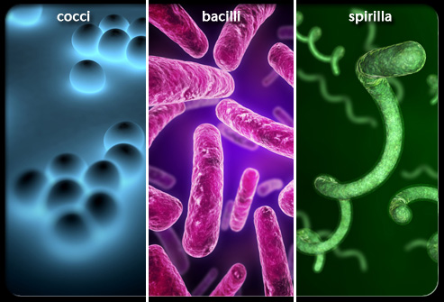
Virus VS. Bacteria (2. Shape)

Slide 13
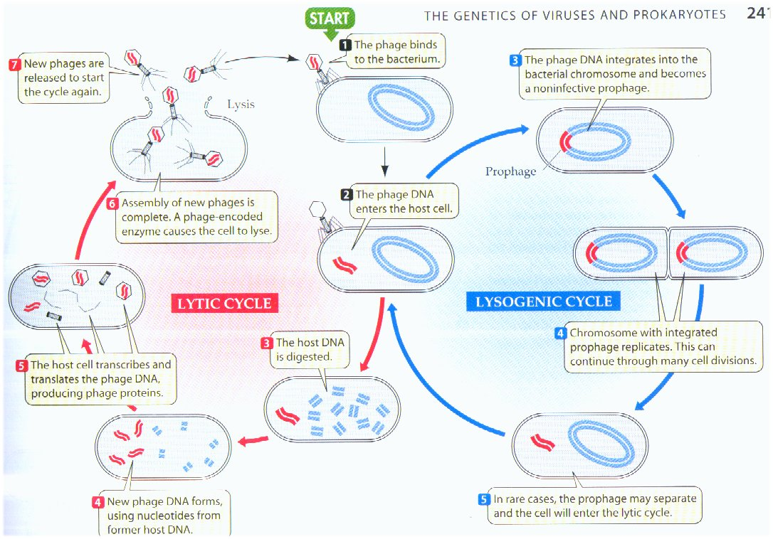
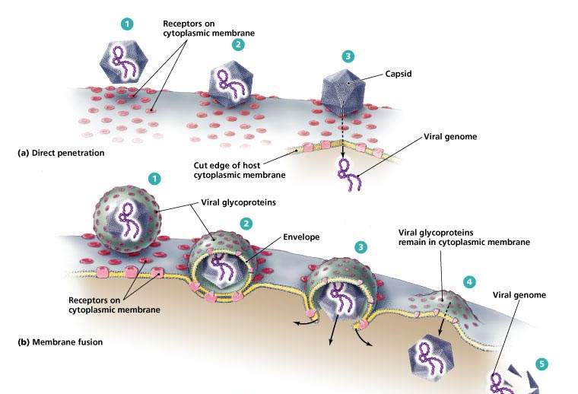
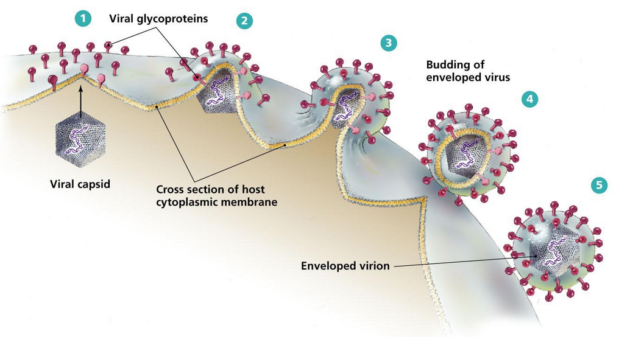
(3. Reproduction) Viral reproduction
Notes:
Entry can occur by direct penetration of the protein coat and insertion of the viral genome (polio and other non-enveloped viruses), fusion of the viral envelope with the host cell membrane (measles and mumps viruses).
Nonenveloped viruses are released by cell lysis, but enveloped forms are released by budding. Budding occurs when the nucleocapsid migrates to and is surrounded by a portion of host cell membrane from either the nucleus, endoplasmic reticulum or outer membrane. During synthesis, viral protein spikes such as neuraminidase and hemagluttinin are added to the host membrane.

Slide 14
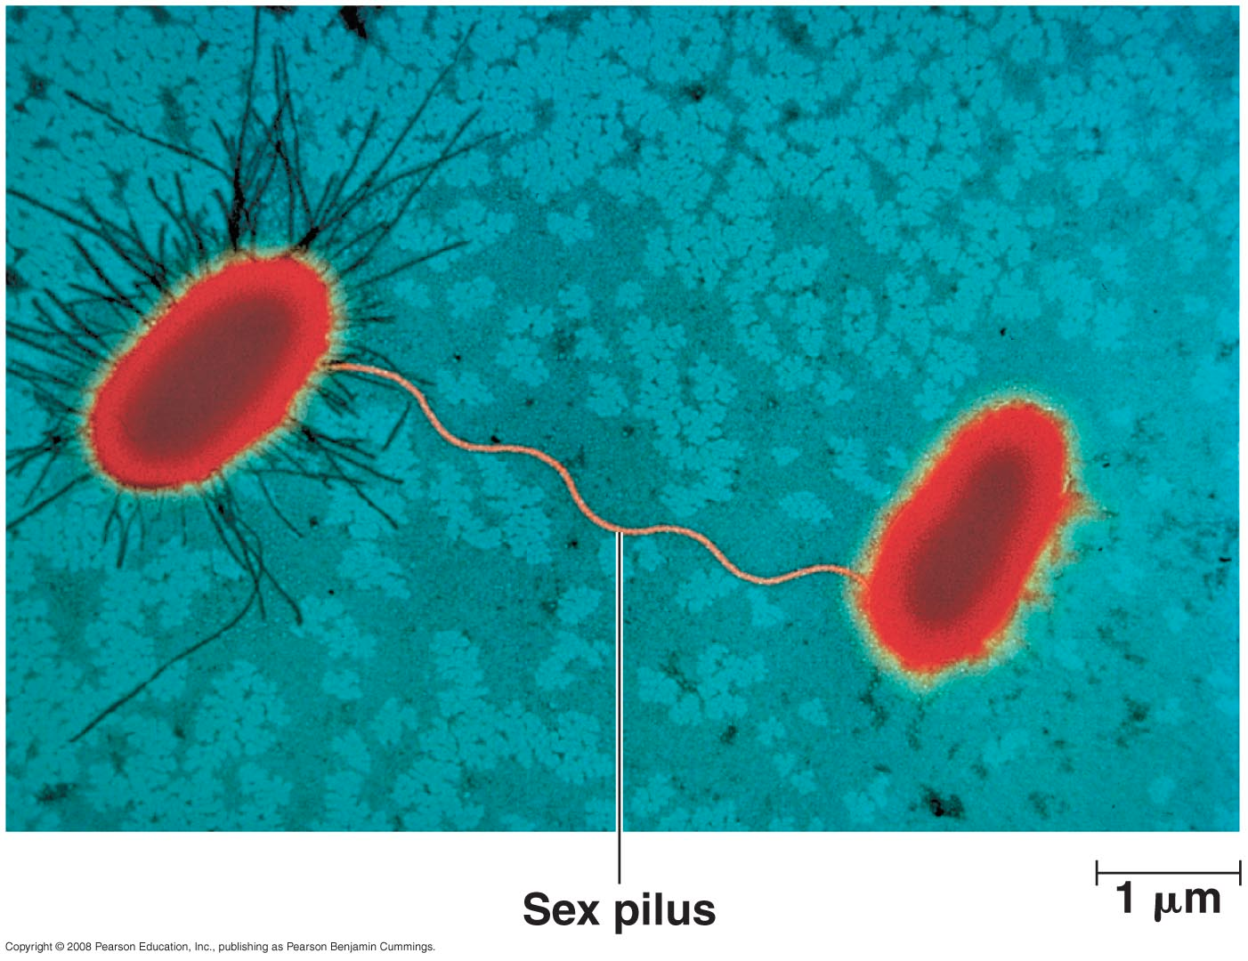
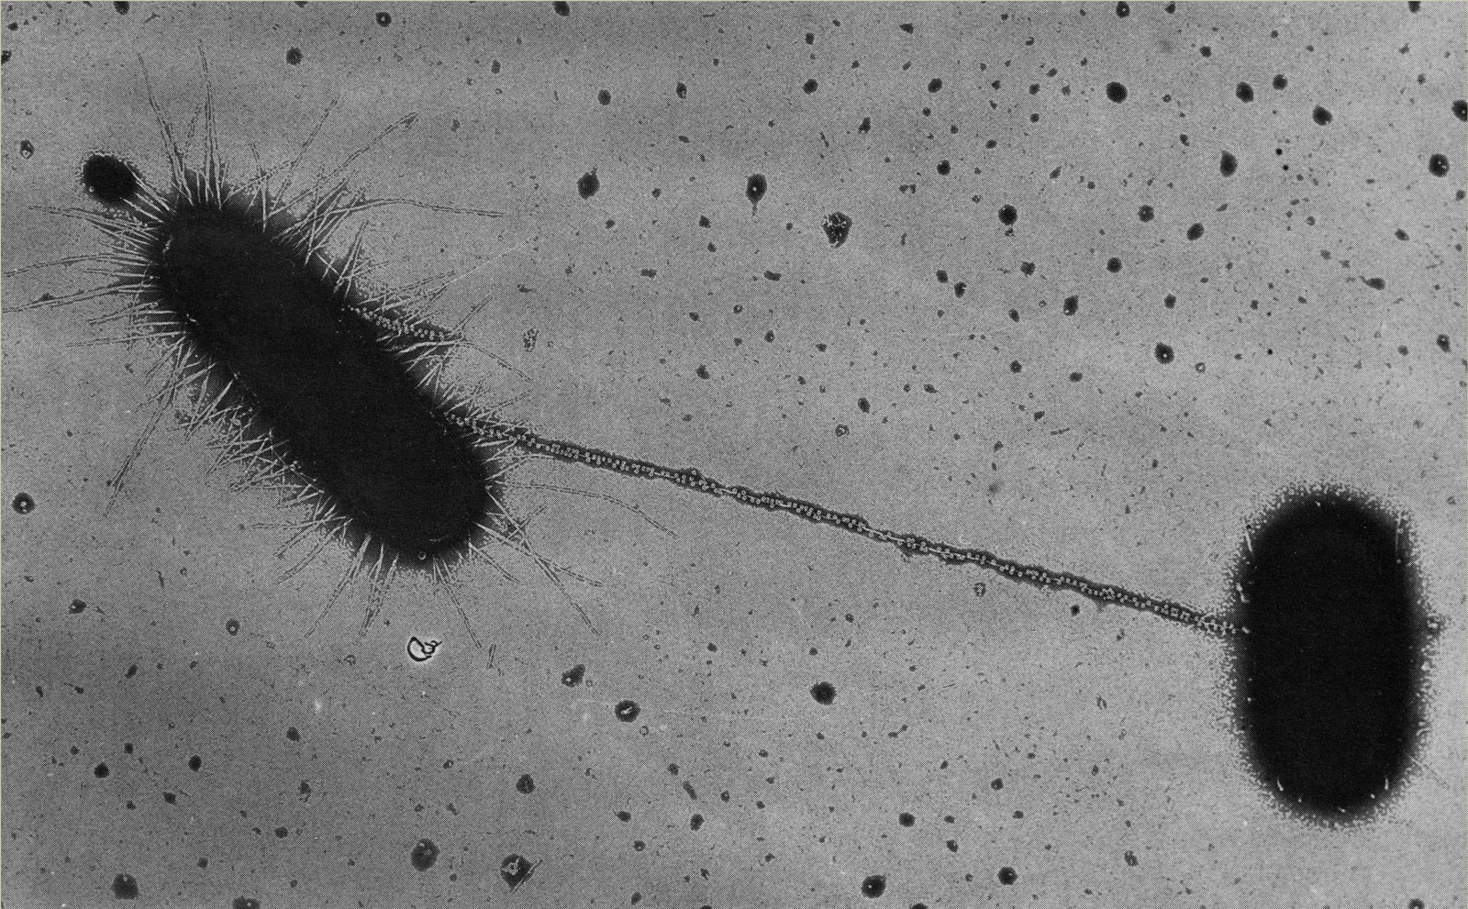
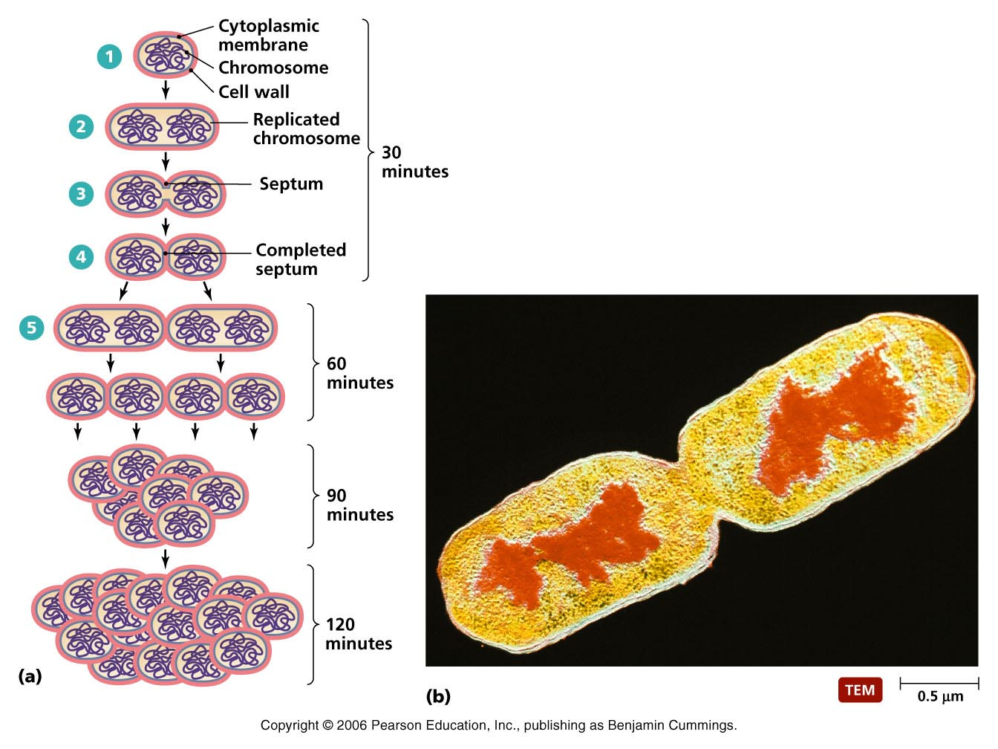
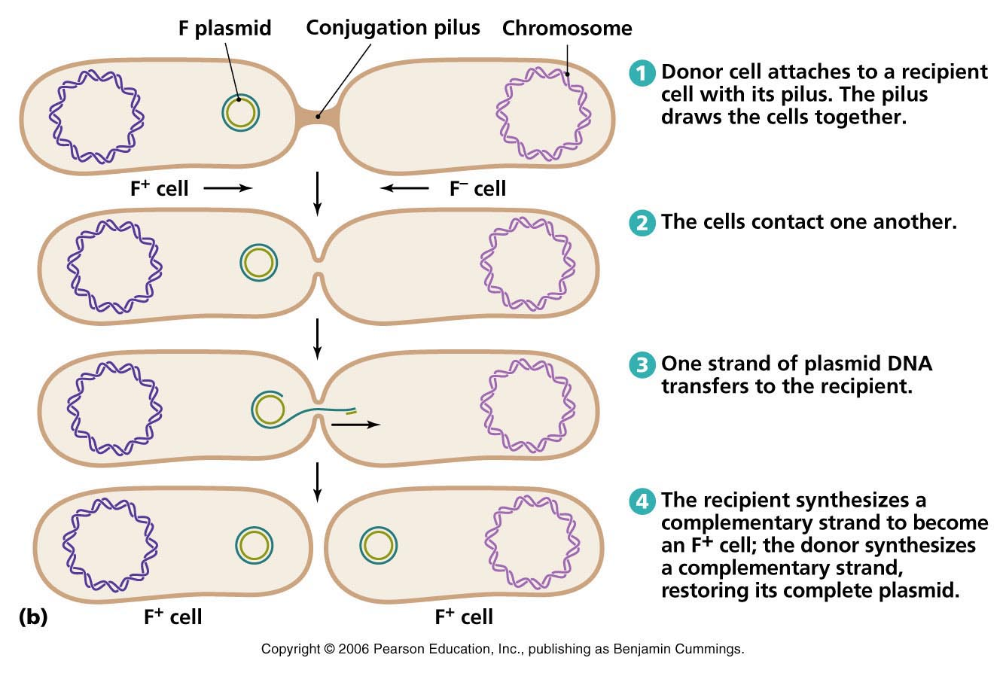
(3. Reproduction) Bacteria reproduction

Slide 15
Summary on VIRUS VS. BACTERIA

Slide 16
Select a bacterial/viral pathogen to research on (follow the instructions on the class site)

