Slide 1
Digestive System Jeopardy GAME
Health Science II - Ms. Sarina

Slide 2
Instructions
Group the class into 5 groups
Have each group pick a dollar value ($100, $200, $300, $400, higher value represents more difficult questions)
after the teacher read the question, Each group have maximum of 15 seconds to answer the question by writing the answer on the board (to avoid any miscommunication)
Groups with highest score receive full mark for today’s class activity (10 points)

Slide 3
The Digestive System
Structure and Function of the Digestive Tract (Alimentary Cannel) | Structure and Function of the Accessary Organs | Processes in the Digestive System
$100
$100
$100
$100
$100
$100
$100
$200
$200
$200
$100
$100
$100
$100
$300
$300
$300
$200
$200
$200
$200
$300
$300
$300
$200
$200
$300
$300
$400
$400
$400
$300

Slide 4
$300 Question
Match the following phase with appropriate process
A) mechanical breakdown
B) propulsion
C) defecation
D) ingestion
E) absorption
F) digestion
1. placement of food into the mouth
2. peristalsis moves food from one organ to the next
3. transport of food products from the lumen of the GI tract to the blood or lymph
4. physically fragmenting food particles into smaller particles
5. elimination of indigestible food residues from the GI tract as feces
6. enzymatic reactions that hydrolyze food particles into their building blocks
Answer
End
Return

Slide 5
$300 Question
Match the following phase with appropriate process
1) mechanical breakdown D.
2) Propulsion B.
3) Defecation E.
4) Ingestion A.
5) Absorption C.
6) Digestion F.
A. placement of food into the mouth
B. peristalsis moves food from one organ to the next
C. transport of food products from the lumen of the GI tract to the blood or lymph
D. physically fragmenting food particles into smaller particles
E. elimination of indigestible food residues from the GI tract as feces
F. enzymatic reactions that hydrolyze food particles into their building blocks
Return

Slide 6
$400 Question
Match the digestive organ with their primary functions:
1) Stomach
2) Esophagus
3) Small intestine
4) large intestine
5) Mouth
A) organ where carbohydrate absorption occurs
B) organ where starch digestion begins
C) tube through which food is propelled to the stomach but lacks a digestive role
D) organ where protein digestion begins
E) organ where pancreatic enzymes and bile enter the alimentary canal
F) organ where bacteria synthesize vitamin K
G) organ where defecation reflex is initiated
Answer
End
Return

Slide 7
$400 Question
Match the digestive organ with their primary functions:
1) Stomach D
2) Esophagus C
3) Small intestine A and/or E
4) large intestine G
5) Mouth B
A) organ where carbohydrate absorption occurs
B) organ where starch digestion begins
C) tube through which food is propelled to the stomach but lacks a digestive role
D) organ where protein digestion begins
E) organ where pancreatic enzymes and bile enter the alimentary canal
F) organ where bacteria synthesize vitamin K
G) organ where defecation reflex is initiated
Return

Slide 8
$400 Question
Match the following nutrients with their associated digestive enzymes:
1) Protein
2) Lactose
3) Starch
4) Fat
5) Nucleic acids
A) pepsin
B) nuclease
C) lipase
D) lactase
E) amylase
Answer
End
Return

Slide 9
$400 Question
Match the following nutrients with their associated digestive enzymes:
1) Protein A
2) Lactose D
3) Starch E
4) Fat C
5) Nucleic acids B
A) pepsin
B) nuclease
C) lipase
D) lactase
E) amylase
Return

Slide 10
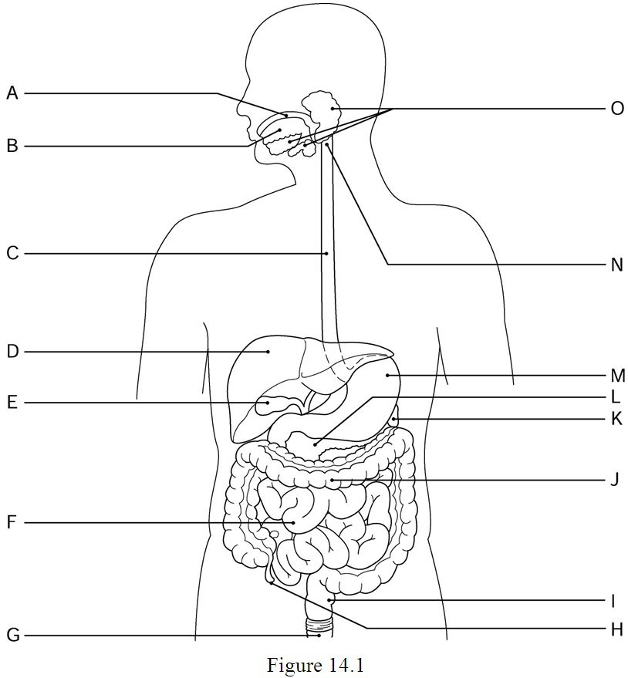
$400 Question
Identify the structures A to O
Answer
End
Return

Slide 11
$400 Question
Identify the structures A to O
A. Mouth
B. Tongue
C. Esophagus
D. Liver
E. Gall bladder
F. Small intestine
G. Anus
O. Salivary Glad
N. Pharynx
M. Stomach
L. Pancreas
K. Pancreas
J. Large intestine
I. Rectum
H. Appendix
Return

Slide 12
$100 Question
The process of physically and chemically breaking food particles down is referred to as ________.
A) digestion
B) defecation
C) ingestion
D) absorption
Answer
End
Return

Slide 13
$100 Question
The process of physically and chemically breaking food particles down is referred to as ________.
A) digestion
B) defecation
C) ingestion
D) absorption
Return

Slide 14
$100 Question
The ________ runs from the pharynx through the diaphragm to the stomach.
A) trachea
B) esophagus
C) larynx
D) small intestine
Answer
End
Return

Slide 15
$100 Question
The ________ runs from the pharynx through the diaphragm to the stomach.
A) trachea
B) esophagus
C) larynx
D) small intestine
Return

Slide 16
$300 Question
The ________ sphincter, or valve, controls food movement from the stomach into the small intestine.
A) ileocecal
B) cardioesophageal
C) pyloric
D) anal
Answer
End
Return

Slide 17
$300 Question
The ________ sphincter, or valve, controls food movement from the stomach into the small intestine.
A) ileocecal
B) cardioesophageal
C) pyloric
D) anal
Return

Slide 18
$200 Question
Large wrinkle-like folds in the stomach lining, present when the stomach is empty, that allow for expansion when the stomach is filling are called ________.
A) villi
B) haustra
C) microvilli
D) rugae
Answer
End
Return

Slide 19
$200 Question
Large wrinkle-like folds in the stomach lining, present when the stomach is empty, that allow for expansion when the stomach is filling are called ________.
A) villi
B) haustra
C) microvilli
D) rugae
Return

Slide 20
$200 Question
The three subdivisions of the small intestine are ________.
A) cecum, colon, rectum
B) duodenum, jejunum, ileum
C) cardiac, body, pylorus
D) ileum, cecum, rectum
Answer
End
Return

Slide 21
$200 Question
The three subdivisions of the small intestine are ________.
A) cecum, colon, rectum
B) duodenum, jejunum, ileum
C) cardiac, body, pylorus
D) ileum, cecum, rectum
Return

Slide 22
$200 Question
The fingerlike projections of the small intestine increase the surface area and are known as ________.
A) haustra
B) cilia
C) villi
D) rugae
Answer
End
Return

Slide 23
$200 Question
The fingerlike projections of the small intestine increase the surface area and are known as ________.
A) haustra
B) cilia
C) villi
D) rugae
Return

Slide 24
$100 Question
Bile is formed by the ________.
A) spleen
B) liver
C) gallbladder
D) pancreas
Answer
End
Return

Slide 25
$100 Question
Bile is formed by the ________.
A) spleen
B) liver
C) gallbladder
D) pancreas
Return

Slide 26
$100 Question
The process of chewing is known as ________.
A) deglutition
B) segmentation
C) peristalsis
D) mastication
Answer
End
Return

Slide 27
$100 Question
The process of chewing is known as ________.
A) deglutition
B) segmentation
C) peristalsis
D) mastication
Return

Slide 28
$200 Question
The enzyme produced by the salivary glands used in the breakdown of starches is salivary ________.
A) chymotrypsin
B) nuclease
C) amylase
D) lipase
Answer
End
Return

Slide 29
$200 Question
The enzyme produced by the salivary glands used in the breakdown of starches is salivary ________.
A) chymotrypsin
B) nuclease
C) amylase
D) lipase
Return

Slide 30
$100 Question
The active, voluntary process of placing food in one's mouth is ________.
A) defecation
B) ingestion
C) mastication
D) deglutition
Answer
End
Return

Slide 31
$100 Question
The active, voluntary process of placing food in one's mouth is ________.
A) defecation
B) ingestion
C) mastication
D) deglutition
Return

Slide 32
$100 Question
When digestion is not occurring in the small intestine, bile is stored in the ________.
A) liver
B) gallbladder
C) pancreas
D) spleen
Answer
End
Return

Slide 33
$100 Question
When digestion is not occurring in the small intestine, bile is stored in the ________.
A) liver
B) gallbladder
C) pancreas
D) spleen
Return

Slide 34
$100 Question
The process of eliminating indigestible residues from the GI tract is called ________.
A) deglutition
B) segmentation
C) mastication
D) defecation
Answer
End
Return

Slide 35
$100 Question
The process of eliminating indigestible residues from the GI tract is called ________.
A) deglutition
B) segmentation
C) mastication
D) defecation
Return

Slide 36
$300 Question
Hydrochloric acid is necessary in the stomach for the conversion of pepsinogen into its active protein-digesting form called ________.
A) pepsin
B) rennin
C) amylase
D) peptidase
Answer
End
Return

Slide 37
$300 Question
Hydrochloric acid is necessary in the stomach for the conversion of pepsinogen into its active protein-digesting form called ________.
A) pepsin
B) rennin
C) amylase
D) peptidase
Return

Slide 38
$100 Question
Sugars and starches are types of organic compounds known as ________.
A) nucleic acids
B) lipids
C) proteins
D) carbohydrates
Answer
End
Return

Slide 39
$100 Question
Sugars and starches are types of organic compounds known as ________.
A) nucleic acids
B) lipids
C) proteins
D) carbohydrates
Return

Slide 40
$300 Question
2) Which one of the following represents the correct order through which food passes in the alimentary canal?
A) mouth, pharynx, esophagus, stomach, large intestine, small intestine
B) mouth, esophagus, pharynx, stomach, small intestine, large intestine
C) pharynx, mouth, esophagus, stomach, large intestine, small intestine
D) mouth, pharynx, esophagus, stomach, small intestine, large intestine
E) mouth, pharynx, esophagus, small intestine, stomach, large intestine
Answer
End
Return

Slide 41
$300 Question
2) Which one of the following represents the correct order through which food passes in the alimentary canal?
A) mouth, pharynx, esophagus, stomach, large intestine, small intestine
B) mouth, esophagus, pharynx, stomach, small intestine, large intestine
C) pharynx, mouth, esophagus, stomach, large intestine, small intestine
D) mouth, pharynx, esophagus, stomach, small intestine, large intestine
E) mouth, pharynx, esophagus, small intestine, stomach, large intestine
Return

Slide 42
$300 Question
What sphincter regulates the passage of food from the esophagus into the stomach?
A) internal anal sphincter
B) external anal sphincter
C) ileocecal sphincter
D) pyloric sphincter
E) cardioesophageal sphincter
Answer
End
Return

Slide 43
$300 Question
What sphincter regulates the passage of food from the esophagus into the stomach?
A) internal anal sphincter
B) external anal sphincter
C) ileocecal sphincter
D) pyloric sphincter
E) cardioesophageal sphincter
Return

Slide 44
$300 Question
The small intestine extends from the ________.
A) cardioesophageal sphincter to the pyloric sphincter (valve)
B) pyloric sphincter (valve) to the ileocecal valve
C) ileocecal valve to the appendix
D) appendix to the sigmoid colon
E) cardioesophageal sphincter to ileocecal valve
Answer
End
Return

Slide 45
$300 Question
The small intestine extends from the ________.
A) cardioesophageal sphincter to the pyloric sphincter (valve)
B) pyloric sphincter (valve) to the ileocecal valve
C) ileocecal valve to the appendix
D) appendix to the sigmoid colon
E) cardioesophageal sphincter to ileocecal valve
Return

Slide 46
$300 Question
What organs release secretions into the duodenum of the small intestine?
A) pancreas and spleen
B) appendix and liver
C) liver and pancreas
D) cecum and appendix
E) spleen and liver
Answer
End
Return

Slide 47
$300 Question
What organs release secretions into the duodenum of the small intestine?
A) pancreas and spleen
B) appendix and Peyer's patches
C) liver and pancreas
D) cecum and appendix
E) spleen and liver
Return

Slide 48
$200 Question
Enzymes and bile are carried by the pancreatic duct and bile duct into the ________.
A) duodenum
B) jejunum
C) ileocecal valve
D) ileum
E) large intestine
Answer
End
Return

Slide 49
$200 Question
Enzymes and bile are carried by the pancreatic duct and bile duct into the ________.
A) duodenum
B) jejunum
C) ileocecal valve
D) ileum
E) large intestine
Return

Slide 50
$100 Question
One of the main functions of the small intestine is ________.
A) absorption of nutrients
B) absorption of water
C) waste secretion
D) vitamin conversion
E) mineral secretion
Answer
End
Return

Slide 51
$100 Question
One of the main functions of the small intestine is ________.
A) absorption of nutrients
B) absorption of water
C) waste secretion
D) vitamin conversion
E) mineral secretion
Return

Slide 52
$200 Question
Which one of the following is NOT a subdivision of the large intestine?
A) cecum
B) appendix
C) duodenum
D) colon
E) rectum
Answer
End
Return

Slide 53
$200 Question
Which one of the following is NOT a subdivision of the large intestine?
A) cecum
B) appendix
C) duodenum
D) colon
E) rectum
Return

Slide 54
$100 Question
The organ responsible for drying out indigestible food residue through water absorption and the elimination of feces is the ________.
A) stomach
B) large intestine
C) small intestine
D) pancreas
E) liver
Answer
End
Return

Slide 55
$100 Question
The organ responsible for drying out indigestible food residue through water absorption and the elimination of feces is the ________.
A) stomach
B) large intestine
C) small intestine
D) pancreas
E) liver
Return

Slide 56
$200 Question
What is the purpose of mastication?
A) to eliminate undigested food wastes from the body
B) to propel food from one digestive organ to the next
C) to transport nutrients into the blood and lymph
D) to chew, grind and tear food into smaller pieces while in the mouth
E) to move food back and forth along the walls of the small intestine
Answer
End
Return

Slide 57
$200 Question
What is the purpose of mastication?
A) to eliminate undigested food wastes from the body
B) to propel food from one digestive organ to the next
C) to transport nutrients into the blood and lymph
D) to chew, grind and tear food into smaller pieces while in the mouth
E) to move food back and forth along the walls of the small intestine
Return

Slide 58
$200 Question
The propulsive process that moves food from one organ to the next is called ________.
A) ingestion
B) peristalsis
C) digestion
D) mastication
E) absorption
Answer
End
Return

Slide 59
$200 Question
The propulsive process that moves food from one organ to the next is called ________.
A) ingestion
B) peristalsis
C) digestion
D) mastication
E) absorption
Return

Slide 60
$100 Question
Proteins are digested to their building blocks which are called ________.
A) peptides
B) amino acids
C) polypeptides
D) fatty acids
E) glycerol
Answer
End
Return

Slide 61
$100 Question
Proteins are digested to their building blocks which are called ________.
A) peptides
B) amino acids
C) polypeptides
D) fatty acids
E) glycerol
Return

Slide 62
$200 Question
Which one of the following alimentary segments has NO digestive function?
A) cardial region of the stomach
B) pyloric region of the stomach
C) mouth
D) esophagus
E) duodenum
Answer
End
Return

Slide 63
$200 Question
Which one of the following alimentary segments has NO digestive function?
A) cardial region of the stomach
B) pyloric region of the stomach
C) mouth
D) esophagus
E) duodenum
Return

Slide 64
$300 Question
Digestion of proteins begins in the ________________.
A) large intestine
B) mouth
C) small intestine.
D) stomach
E) liver
Answer
End
Return

Slide 65
$300 Question
Digestion of proteins begins in the ________________.
A) large intestine
B) mouth
C) small intestine
D) stomach
E) liver
Return

Slide 66
$300 Question
Which layer of the alimentary canal surrounds the lumen?
A) chyme
B) mucus
C) epithelium
D) smooth muscle
E) bolus
Answer
End
Return

Slide 67
$300 Question
Which layer of the alimentary canal surrounds the lumen?
A) chyme
B) mucus
C) epithelium
D) smooth muscle
E) bolus
Return

Slide 68
$300 Question
Organ where carbohydrate absorption occurs
A) stomach
B) esophagus
C) small intestine
D) large intestine
E) mouth
Answer
End
Return

Slide 69
$300 Question
Organ where carbohydrate absorption occurs
A) stomach
B) esophagus
C) small intestine
D) large intestine
E) mouth
Return

Slide 70
$300 Question
What is the terminal (last) portion of the small intestine?
A) pyloric sphincter
B) ileum
C) cardioesophageal sphincter
D) cecum
E) ileocecal valve
Answer
End
Return

Slide 71
$300 Question
What is the terminal (last) portion of the small intestine?
A) pyloric sphincter
B) ileum
C) cardioesophageal sphincter
D) cecum
E) ileocecal valve
Return

