Slide 1
The Digestive System Functions
Ingestion—taking in food
Digestion—breaking food into nutrient molecules
Absorption—movement of nutrients into the bloodstream
Defecation—elimination of indigestible waste

Slide 2
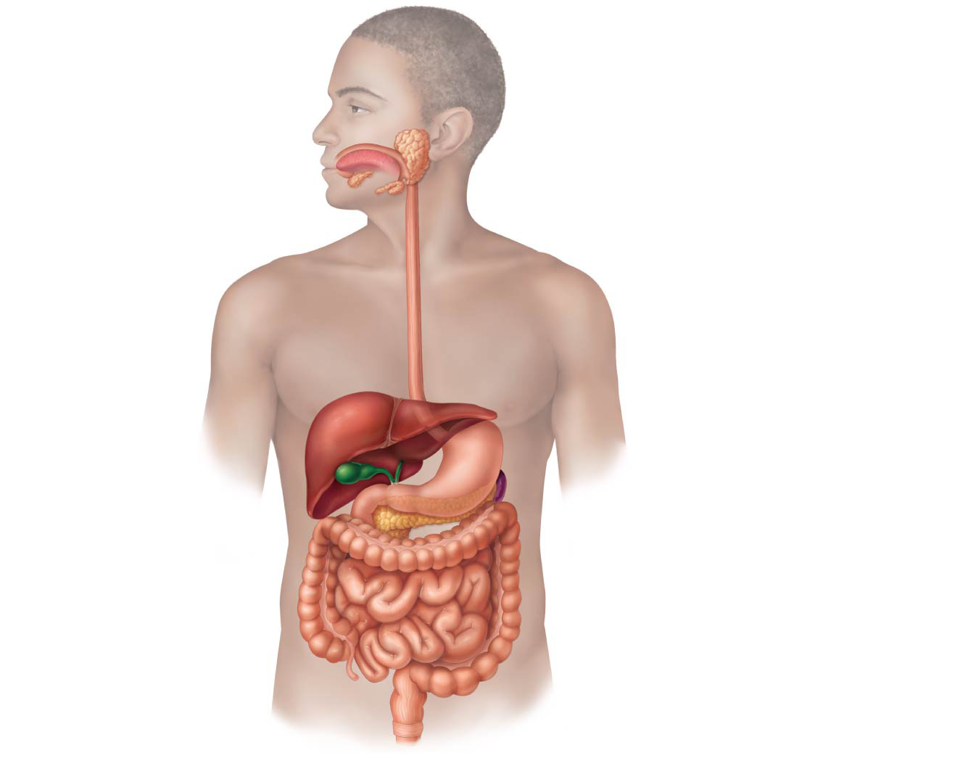
Figure 14.1 The human digestive system: Alimentary canal and accessory organs.
Mouth (oral cavity)
Parotid gland
Tongue
Sublingual gland
Salivary glands
Submandibular
gland
Esophagus
Pharynx
Stomach
Pancreas
(Spleen)
Liver
Gallbladder
Transverse colon
Duodenum
Descending colon
Small
intestine
Jejunum
Ileum
Ascending colon
Cecum
Large intestine
Sigmoid colon
Rectum
Appendix
Anus
Anal canal

Slide 3
Organs of the Digestive System
Two main groups of organs
Alimentary canal (gastrointestinal or GI tract)—continuous, coiled, hollow tube
These organs ingest, digest, absorb, defecate
Mouth
Pharynx
Esophagus
Stomach
Small intestine
Large intestine
Anus
Accessory digestive organs
Includes teeth, tongue, and other large digestive organs

Slide 4
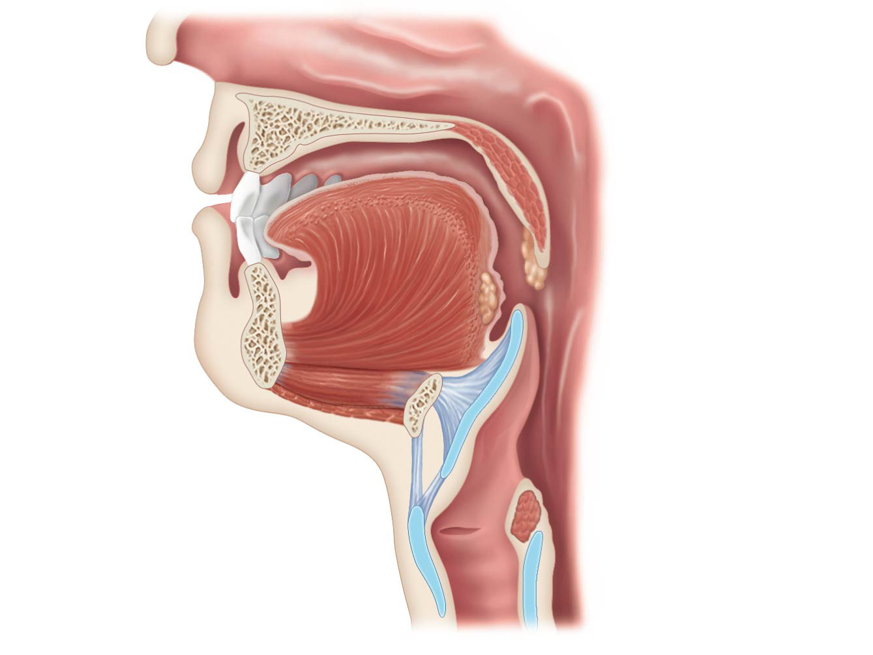
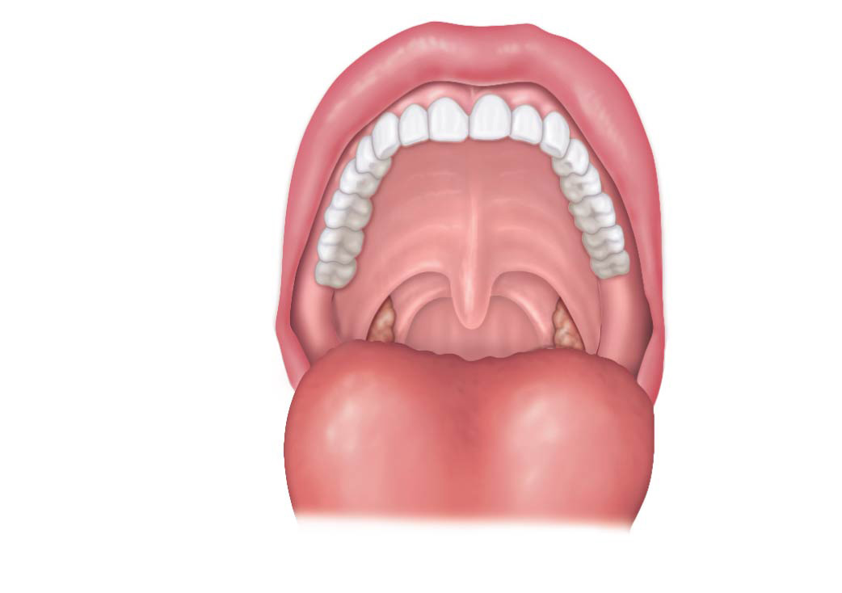
Mouth
Functions of the mouth
Mastication (chewing) of food
Tongue mixes masticated food with saliva
Tongue initiates swallowing
Taste buds on the tongue allow for taste

Slide 5
Pharynx
Food passes from the mouth posteriorly into the:
Oropharynx—posterior to oral cavity
Laryngopharynx—below the oropharynx and continuous with the esophagus

Slide 6
Pharynx
The pharynx serves as a passageway for food, fluids, and air
Food is propelled to the esophagus by two skeletal muscle layers in the pharynx
Longitudinal inner layer
Circular outer layer
Alternating contractions of the muscle layers (peristalsis) propel the food

Slide 7
Esophagus (Gullet)
Anatomy
About 10 inches long
Runs from pharynx to stomach through the diaphragm
Physiology
Conducts food by peristalsis (slow rhythmic squeezing) to the stomach
Passageway for food only (respiratory system branches off after the pharynx)

Slide 8
Layers of Tissue in the Alimentary Canal Organs
Summary of the three layers from innermost to outermost:
Mucosa
Submucosa
Muscularis externa

Slide 9
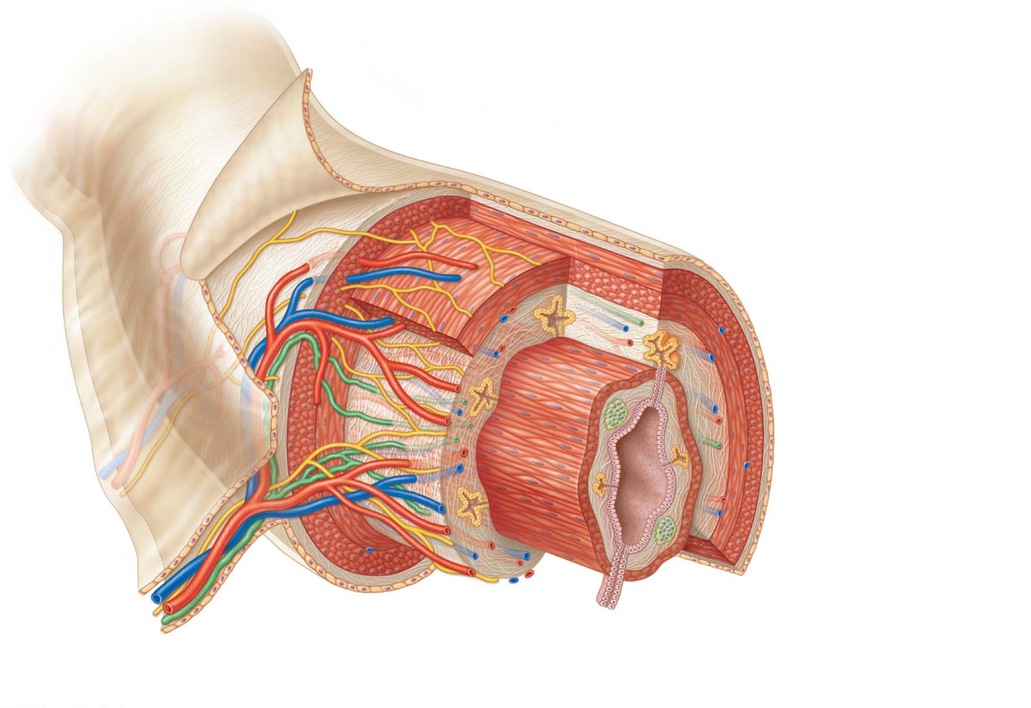
Figure 14.3 Basic structure of the alimentary canal wall.
Visceral peritoneum
Intrinsic nerve plexuses
Myenteric nerve plexus
Submucosal nerve plexus
Submucosal glands
Mucosa
Surface epithelium
Lamina propria
Muscle layer
Submucosa
Muscularis externa
Longitudinal muscle
layer
Circular muscle layer
Serosa
(visceral peritoneum)
Nerve
Gland in
mucosa
Artery
Lumen
Mesentery
Vein
Duct of gland
outside alimentary
canal
Lymphoid tissue

Slide 10
Stomach
The stomach is a C-shaped organ located on the left side of the abdominal cavity
Food enters at the cardioesophageal sphincter from the esophagus
Food empties into the small intestine at the pyloric sphincter (valve)

Slide 11
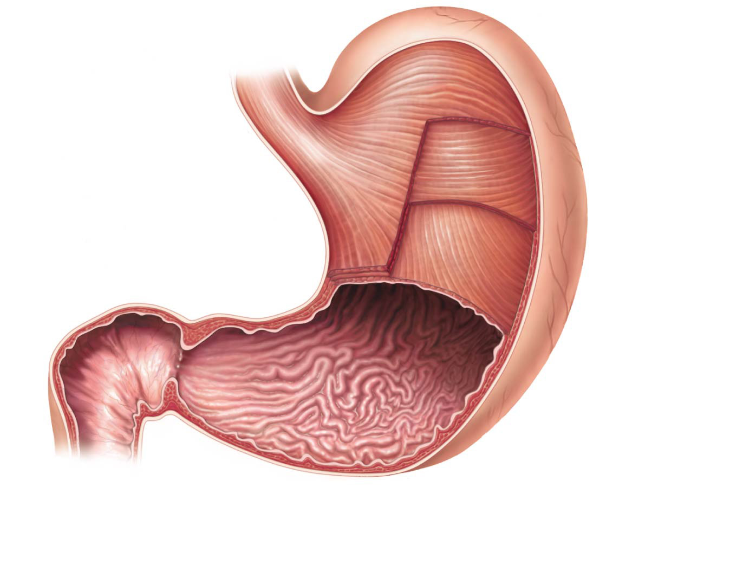
Figure 14.4a Anatomy of the stomach.
Cardia
Fundus
Esophagus
Muscularis
externa
Serosa
Longitudinal layer
Circular layer
Oblique layer
Body
Lesser
curvature
Rugae
of mucosa
Pylorus
Greater
curvature
Duodenum
Pyloric
sphincter
(valve)
Pyloric
antrum
(a)

Slide 12
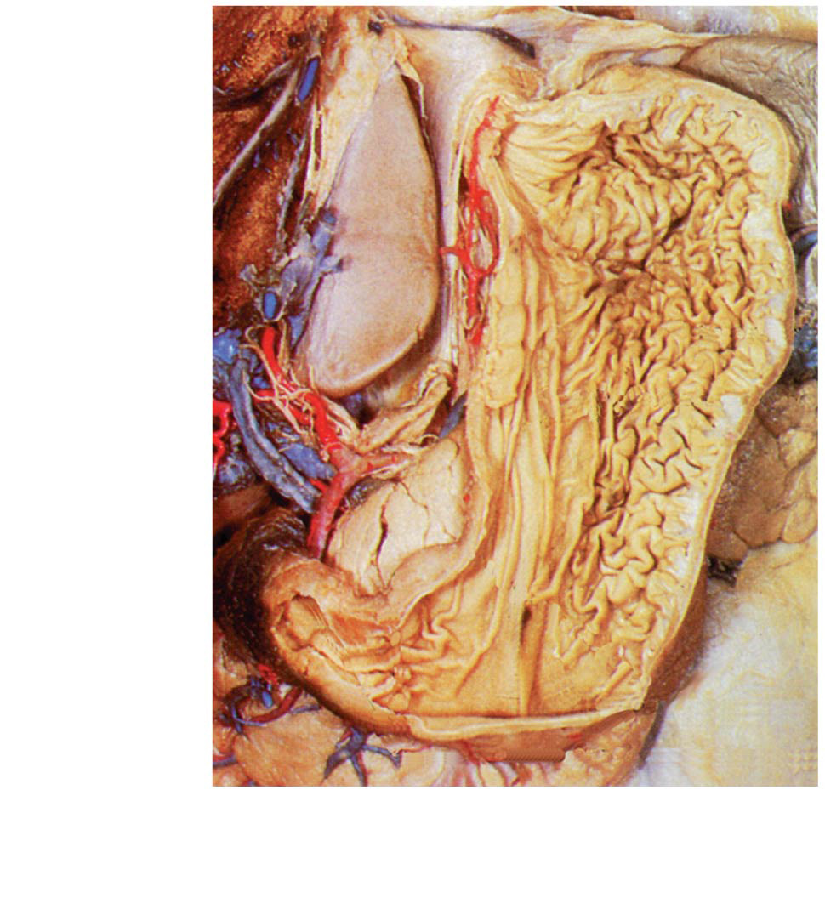
Figure 14.4b Anatomy of the stomach.
Fundus
Body
Rugae
of mucosa
(b)
Pyloric
sphincter
Pyloric
antrum

Slide 13
Stomach
Functions of the stomach
Temporary storage tank for food
Site of food breakdown
Chemical breakdown of protein begins
Delivers chyme (processed food) to the small intestine

Slide 14
Stomach
Structure of the stomach mucosa:
Simple columnar epithelium dotted by gastric pits that lead to gastric glands
Mucous cells produce bicarbonate-rich alkaline mucus
Gastric glands—situated in gastric pits and secrete gastric juice, including:
Intrinsic factor, which is needed for vitamin B₁₂ absorption in the small intestine

Slide 15
Stomach
Structure of the stomach mucosa (continued)
Chief cells—produce protein-digesting enzymes (pepsinogens)
Parietal cells—produce hydrochloric acid
Mucous neck cells—produce thin acidic mucus (different from the mucus produced by cells of the mucosa)
Enteroendocrine cells—produce a hormone called gastrin

Slide 16
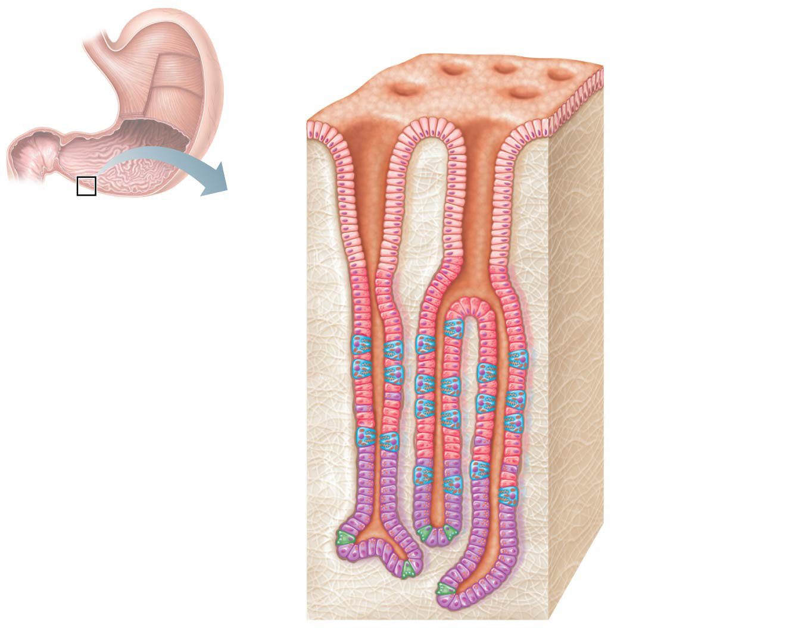
Figure 14.4c Anatomy of the stomach.
Gastric pits
Surface
epithelium
Gastric
pit
Pyloric
sphincter
Mucous
neck cells
Parietal cells
Gastric gland
Gastric
glands
Chief cells
(c)

Slide 17
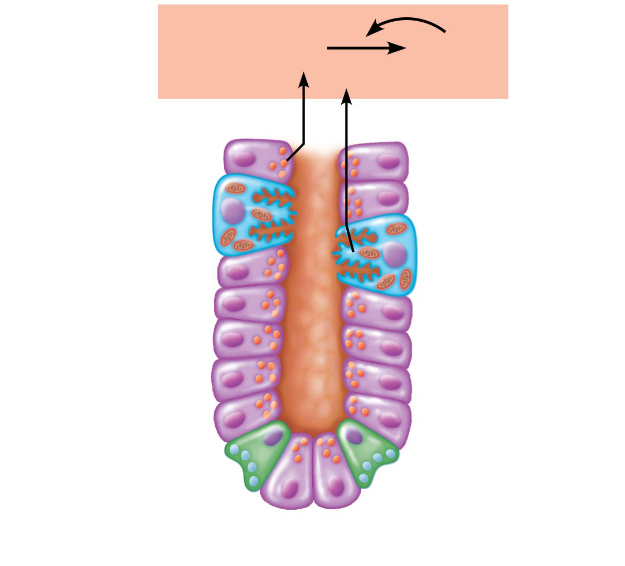
Figure 14.4d Anatomy of the stomach.
Pepsinogen
Pepsin
HCI
Parietal cells
Chief cells
Enteroendocrine
cell
(d)

Slide 18
Small Intestine
The body’s major digestive organ
Longest portion of the alimentary tube (2–4 m or 7–13 feet in a living person)
Site of nutrient absorption into the blood
Muscular tube extending from the pyloric sphincter to the ileocecal valve
Suspended from the posterior abdominal wall by the mesentery

Slide 19
Small Intestine
Subdivisions
Duodenum
Attached to the stomach
Curves around the head of the pancreas
Jejunum
Attaches anteriorly to the duodenum
Ileum
Extends from jejunum to large intestine
Meets the large intestine at the ileocecal valve

Slide 20
Small Intestine
Chemical digestion begins in the small intestine
Enzymes are produced by:
Intestinal cells
Pancreas
Pancreatic ducts carry enzymes to the duodenum
Bile, formed by the liver, enters the duodenum via the bile duct

Slide 21
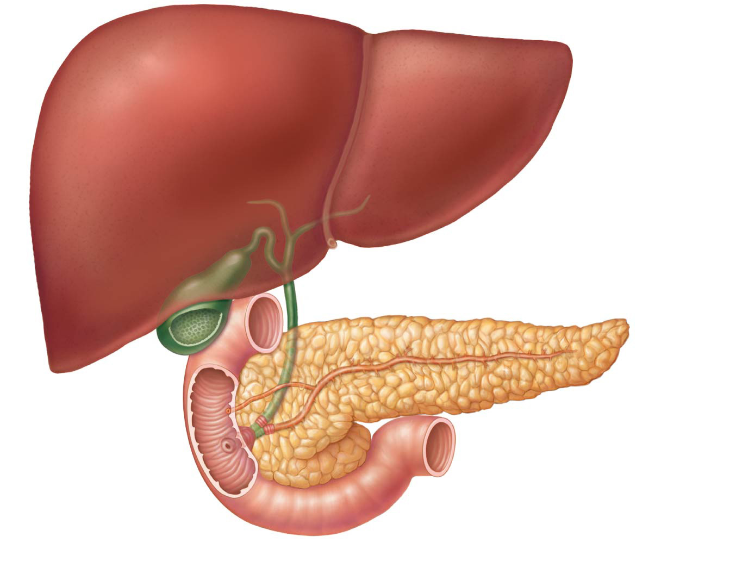
Figure 14.6 The duodenum of the small intestine and related organs.
Right and left
hepatic ducts
from liver
Cystic duct
Common hepatic duct
Bile duct and sphincter
Accessory pancreatic duct
Pancreas
Gallbladder
Jejunum
Duodenal
papilla
Hepatopancreatic
ampulla and sphincter
Main pancreatic duct and sphincter
Duodenum

Slide 22
Small Intestine
Three structural modifications that increase surface area for food absorption
Microvilli—tiny projections of the plasma membrane (create a brush border appearance)
Villi—fingerlike projections formed by the mucosa
House a capillary bed and lacteal
Circular folds (plicae circulares)—deep folds of mucosa and submucosa

Slide 23
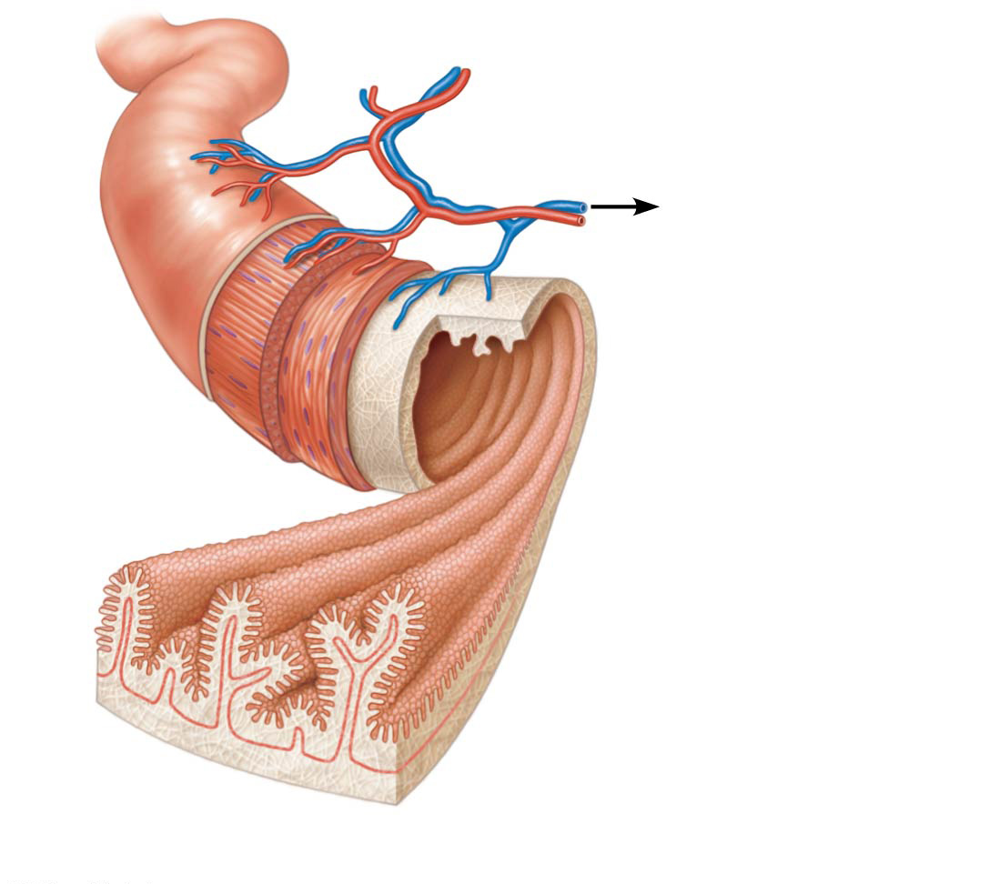
Figure 14.7a Structural modifications of the small intestine.
Blood vessels
serving the small
intestine
Muscle
layers
Lumen
Circular folds
(plicae circulares)
Villi
(a)
Small intestine

Slide 24
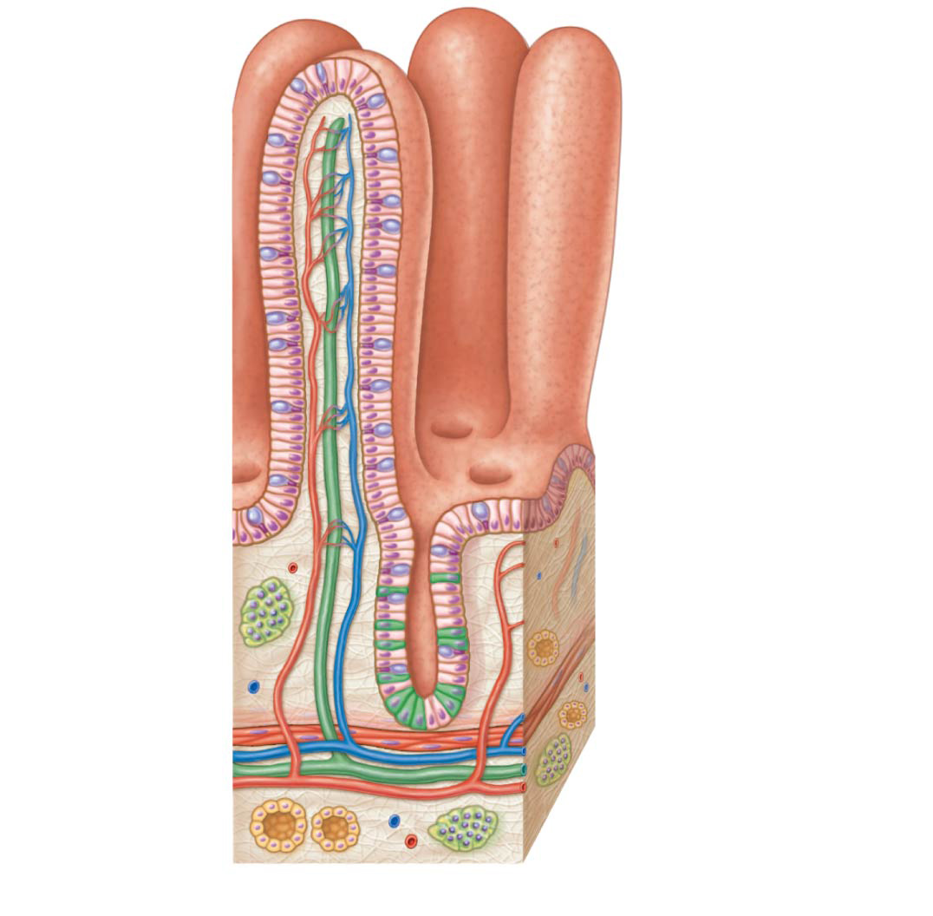
Figure 14.7b Structural modifications of the small intestine.
Absorptive
cells
Lacteal
Villus
Blood
capillaries
Lymphoid
tissue
Intestinal
crypt
Muscularis
mucosae
Venule
Lymphatic vessel
Submucosa
(b)
Villi

Slide 25
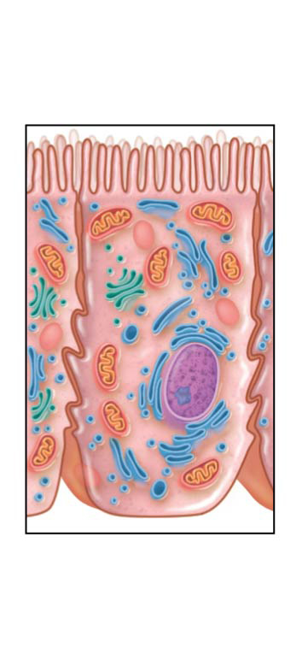
Figure 14.7c Structural modifications of the small intestine.
Microvilli
(brush border)
(c)
Absorptive
cells

Slide 26
Large Intestine
Larger in diameter, but shorter in length at 1.5 m, than the small intestine
Extends from the ileocecal valve to the anus
Subdivisions:
Cecum
Appendix
Colon
Rectum
Anal canal

Slide 27
Large Intestine Anatomy
Cecum—saclike first part of the large intestine
Appendix
Accumulation of lymphoid tissue that sometimes becomes inflamed (appendicitis)
Hangs from the cecum

Slide 28
Large Intestine Anatomy
Colon
Ascending—travels up right side of abdomen
Transverse—travels across the abdominal cavity
Descending—travels down the left side
Sigmoid—S-shaped region; enters the pelvis
Sigmoid colon, rectum, and anal canal are located in the pelvis

Slide 29
Large Intestine Anatomy
Anal canal ends at the anus
Anus—opening of the large intestine
External anal sphincter—formed by skeletal muscle and under voluntary control
Internal anal sphincter—formed by smooth muscle and involuntarily controlled
These sphincters are normally closed except during defecation
The large intestine delivers undigestible food residues to the body’s exterior

Slide 30
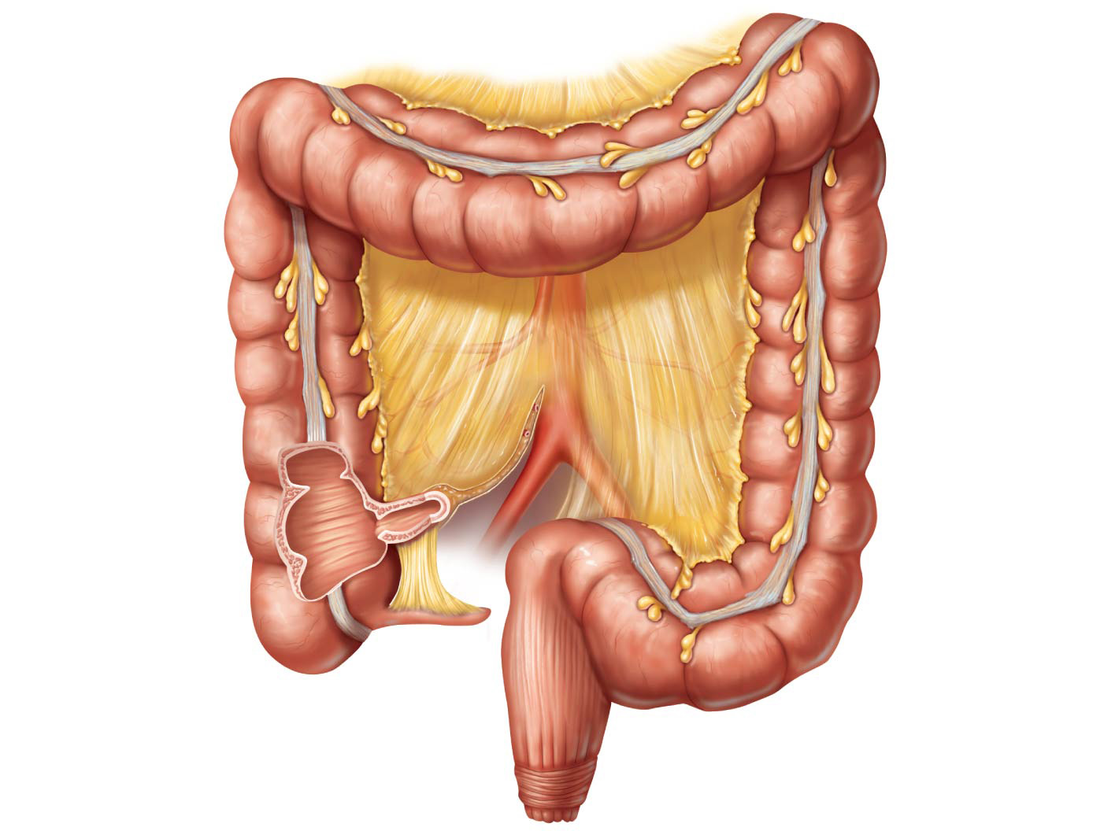
Figure 14.8 The large intestine.
Left colic
(splenic) flexure
Transverse
mesocolon
Right colic
(hepatic) flexure
Transverse
colon
Haustrum
Descending
colon
Ascending colon
Ileum (cut)
Cut edge of
mesentery
Ileocecal valve
Teniae coli
Cecum
Sigmoid
colon
Appendix
Rectum
Anal canal
External anal sphincter

Slide 31
Accessory Digestive Organs
Teeth
Salivary glands
Pancreas
Liver
Gallbladder

Slide 32
Salivary Glands
Three pairs of salivary glands empty secretions into the mouth
Parotid glands
Found anterior to the ears
Submandibular glands
Sublingual glands
Both submandibular and sublingual glands empty saliva into the floor of the mouth through small ducts

Slide 33
Figure 14.1 The human digestive system: Alimentary canal and accessory organs.
Mouth (oral cavity)
Parotid gland
Tongue
Sublingual gland
Salivary glands
Submandibular
gland
Esophagus
Pharynx
Stomach
Pancreas
(Spleen)
Liver
Gallbladder
Transverse colon
Duodenum
Descending colon
Small
intestine
Jejunum
Ileum
Ascending colon
Cecum
Large intestine
Sigmoid colon
Rectum
Appendix
Anus
Anal canal

Slide 34
Salivary Glands
Saliva
Mixture of mucus and serous fluids
Helps to moisten and bind food together into a mass called a bolus
Contains salivary amylase to begin starch digestion
Dissolves chemicals so they can be tasted

Slide 35
Pancreas
Produces a wide spectrum of digestive enzymes that break down all categories of food
Secretes enzymes into the duodenum
Alkaline fluid introduced with enzymes neutralizes acidic chyme coming from stomach
Hormones produced by the pancreas
Insulin
Glucagon

Slide 36
Figure 14.1 The human digestive system: Alimentary canal and accessory organs.
Mouth (oral cavity)
Parotid gland
Tongue
Sublingual gland
Salivary glands
Submandibular
gland
Esophagus
Pharynx
Stomach
Pancreas
(Spleen)
Liver
Gallbladder
Transverse colon
Duodenum
Descending colon
Small
intestine
Jejunum
Ileum
Ascending colon
Cecum
Large intestine
Sigmoid colon
Rectum
Appendix
Anus
Anal canal

Slide 37
Figure 14.6 The duodenum of the small intestine and related organs.
Right and left
hepatic ducts
from liver
Cystic duct
Common hepatic duct
Bile duct and sphincter
Accessory pancreatic duct
Pancreas
Gallbladder
Jejunum
Duodenal
papilla
Hepatopancreatic
ampulla and sphincter
Main pancreatic duct and sphincter
Duodenum

Slide 38
Liver
Largest gland in the body
Located on the right side of the body under the diaphragm
Consists of four lobes suspended from the diaphragm and abdominal wall by the falciform ligament
Connected to the gallbladder via the common hepatic duct

Slide 39
Liver
Bile is produced by cells in the liver
Bile leaves the liver through the common hepatic duct and enters duodenum through the bile duct
Bile is a yellow-green, watery solution containing:
Bile salts and bile pigments (mostly bilirubin from the breakdown of hemoglobin)
Cholesterol, phospholipids, and electrolytes

Slide 40
Liver
Function of bile
Emulsify fats by physically breaking large fat globules into smaller ones

Slide 41
Gallbladder
Sac found in shallow fossa of liver
When no digestion is occurring, bile backs up the cystic duct for storage in the gallbladder
During digestion of fatty food, bile is introduced into the duodenum from the gallbladder
Gallstones are crystallized cholesterol, which can cause blockages

Slide 42
Figure 14.6 The duodenum of the small intestine and related organs.
Right and left
hepatic ducts
from liver
Cystic duct
Common hepatic duct
Bile duct and sphincter
Accessory pancreatic duct
Pancreas
Gallbladder
Jejunum
Duodenal
papilla
Hepatopancreatic
ampulla and sphincter
Main pancreatic duct and sphincter
Duodenum

Slide 43
Functions of the Digestive System
Major functions of the digestive system are summarized as:
Digestion
Absorption
We will cover 6 more specific processes next

Slide 44
Functions of the Digestive System
Ingestion—placing of food into the mouth
Propulsion—movement of foods from one region of the digestive system to another
Peristalsis—alternating waves of contraction and relaxation that squeezes food along the GI tract
Segmentation—movement of materials back and forth to foster mixing in the small intestine

Slide 45
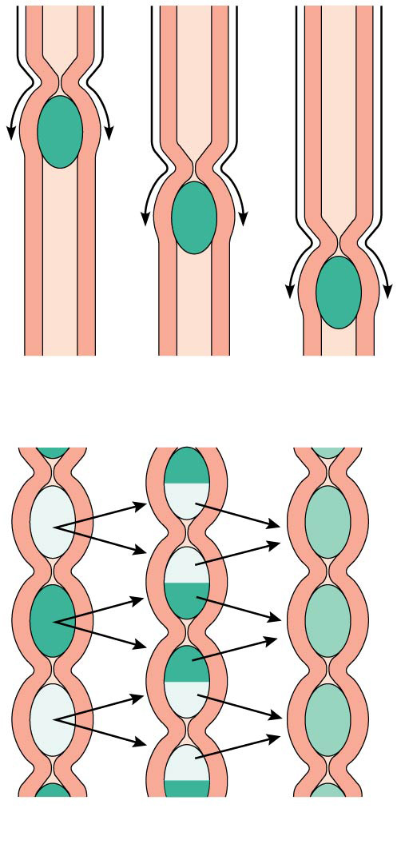
Figure 14.12 Peristaltic and segmental movements of the digestive tract.
(a)
(b)

Slide 46
Functions of the Digestive System
Food breakdown: mechanical breakdown
Examples:
Mixing of food in the mouth by the tongue
Churning of food in the stomach
Segmentation in the small intestine
Mechanical digestion prepares food for further degradation by enzymes

Slide 47
Functions of the Digestive System
Food breakdown: digestion
Digestion occurs when enzymes chemically break down large molecules into their building blocks
Each major food group uses different enzymes
Carbohydrates are broken to monosaccharides (simple sugars)
Proteins are broken to amino acids
Fats are broken to fatty acids and glycerol

Slide 48
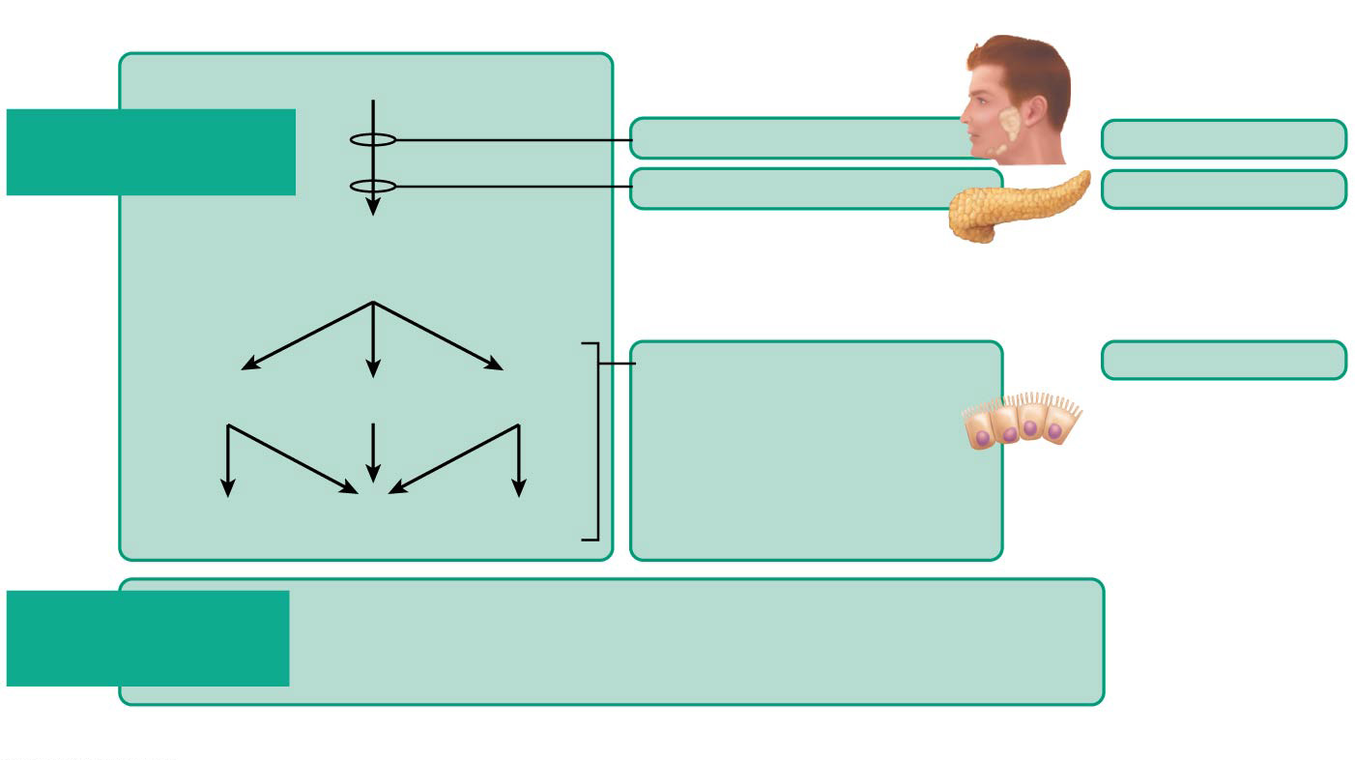
Figure 14.13 Flowchart of digestion and absorption of foodstuffs. (1 of 3)
Foodstuff
Enzyme(s) and source
Site of action
Starch and disaccharides
Digestion of
carbohydrates
Salivary amylase
Mouth
Pancreatic amylase
Small intestine
Oligosaccharides*
and disaccharides
Brush border enzymes
in small intestine
(dextrinase,
glucoamylase,
lactase, maltase,
and sucrase)
Small intestine
Lactose
Maltose
Sucrose
Galactose
Glucose
Fructose
Absorption of
carbohydrates
The monosaccharides glucose, galactose, and
fructose enter the capillary blood in the villi and are
transported to the liver via the hepatic portal vein.
*Oligosaccharides consist of a few linked monosaccharides.

Slide 49
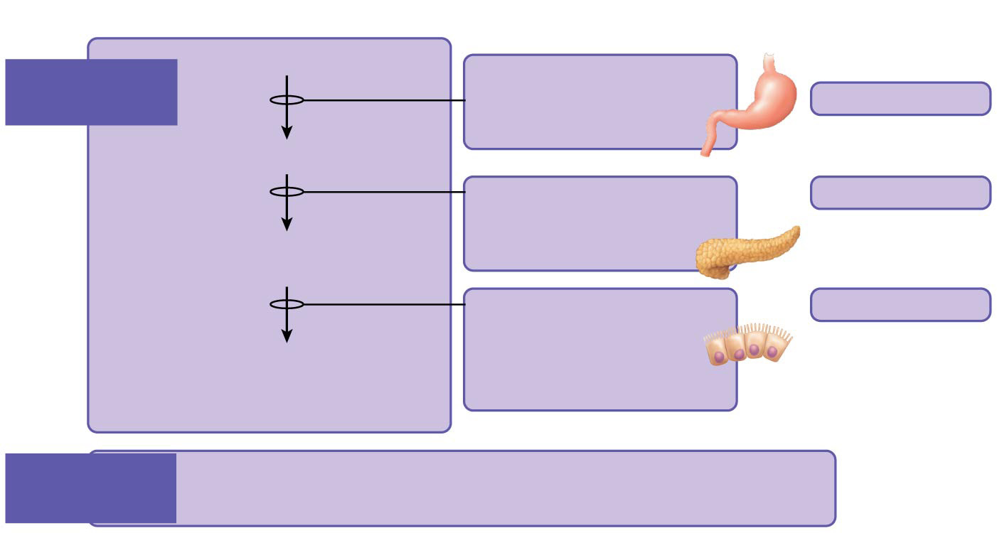
Figure 14.13 Flowchart of digestion and absorption of foodstuffs. (2 of 3)
Foodstuff
Enzyme(s) and source
Site of action
Protein
Pepsin
(stomach glands) in
the presence of HCI
Digestion
of proteins
Stomach
Large polypeptides
Pancreatic enzymes
(trypsin, chymotrypsin,
carboxypeptidase)
Small intestine
Small polypeptides,
small peptides
Brush border enzymes
(aminopeptidase,
carboxypeptidase,
and dipeptidase)
Small intestine
Amino acids
(some dipeptides
and tripeptides)
Absorption
of proteins
Amino acids enter the capillary blood in the villi and are
transported to the liver via the hepatic portal vein.

Slide 50
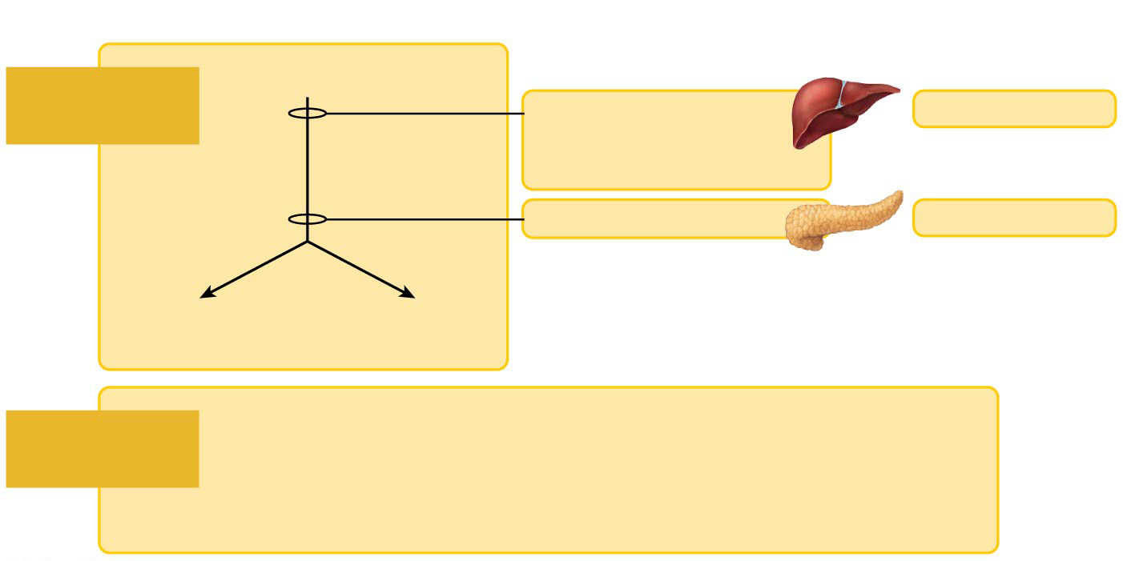
Figure 14.13 Flowchart of digestion and absorption of foodstuffs. (3 of 3)
Foodstuff
Enzyme(s) and source
Site of action
Unemulsified fats
Digestion
of fats
Emulsified by the
detergent action of
bile salts from the liver
Small intestine
Pancreatic lipase
Small intestine
Monoglycerides
and fatty acids
Glycerol and
fatty acids
Fatty acids and monoglycerides enter the lacteals of the villi
and are transported to the systemic circulation via the lymph
in the thoracic duct. (Glycerol and short-chain fatty acids are
absorbed into the capillary blood in the villi and transported
to the liver via the hepatic portal vein.)
Absorption
of fats

Slide 51
Functions of the Digestive System
Absorption
End products of digestion are absorbed in the blood or lymph
Food must enter mucosal cells and then into blood or lymph capillaries
Defecation
Elimination of indigestible substances from the GI tract in the form of feces

Slide 52
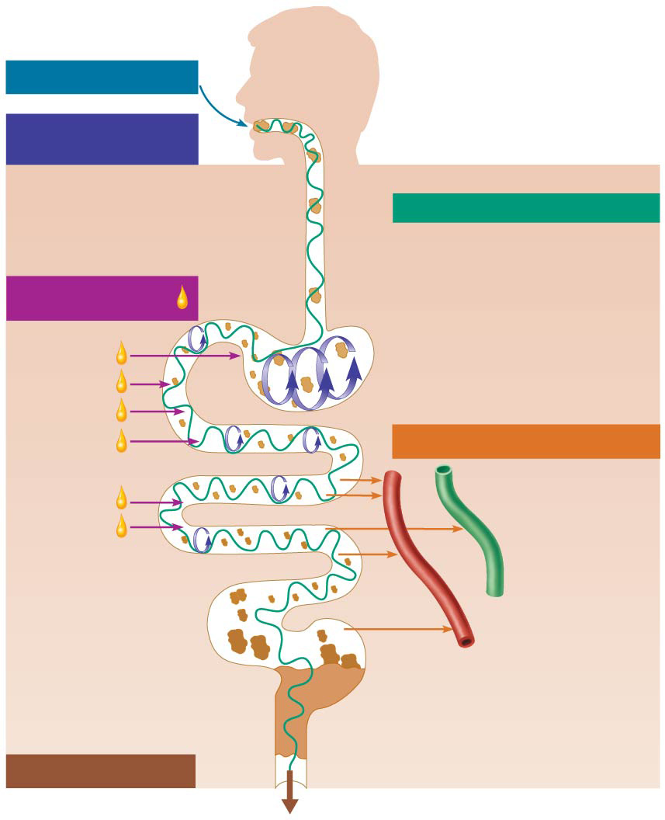
Figure 14.11 Schematic summary of gastrointestinal tract activities.
Ingestion
Food
Mechanical
breakdown
Pharynx
Chewing (mouth)
Esophagus
Churning (stomach)
Propulsion
Segmentation
(small intestine)
Swallowing
(oropharynx)
Digestion
Peristalsis
(esophagus, stomach,
small intestine, large
intestine)
Stomach
Absorption
Lymph vessel
Small intestine
Large intestine
Blood vessel
Mainly H₂O
Feces
Defecation
Anus

Slide 53
Activities Occurring in the Mouth, Pharynx, and Esophagus
Food ingestion and breakdown
Food is placed into the mouth
Physically broken down by chewing
Mixed with saliva, which is released in response to mechanical pressure and psychic stimuli
Salivary amylase begins starch digestion
Essentially, no food absorption occurs in the mouth

Slide 54
Activities Occurring in the Mouth, Pharynx, and Esophagus
Food propulsion—swallowing and peristalsis
Pharynx and esophagus have no digestive function
Serve as passageways to the stomach
Pharynx functions in swallowing (deglutition)

Slide 55
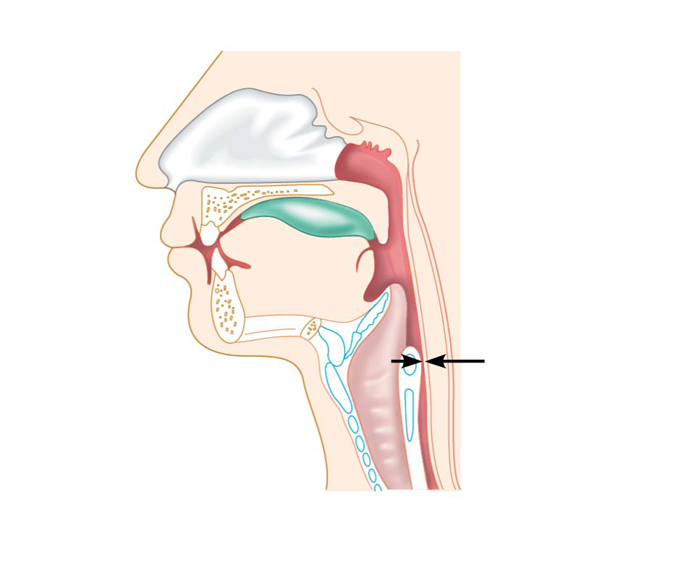
Figure 14.14a Swallowing.
Bolus of food
Tongue
Pharynx
Upper
esophageal
sphincter
Epiglottis
up
Glottis (lumen)
of larynx
Trachea
Esophagus
(a)
Upper esophageal
sphincter contracted

Slide 56
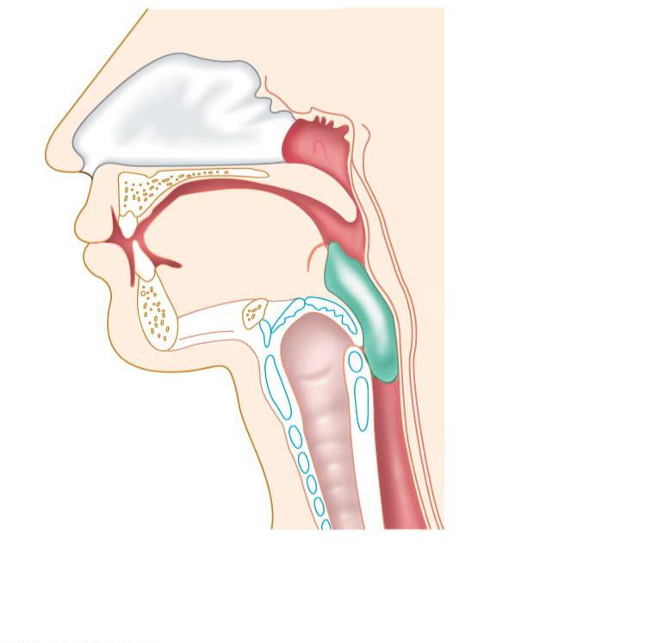
Figure 14.14b Swallowing.
Uvula
Bolus
Epiglottis
down
Larynx up
Esophagus
(b)
Upper esophageal
sphincter relaxed

Slide 57
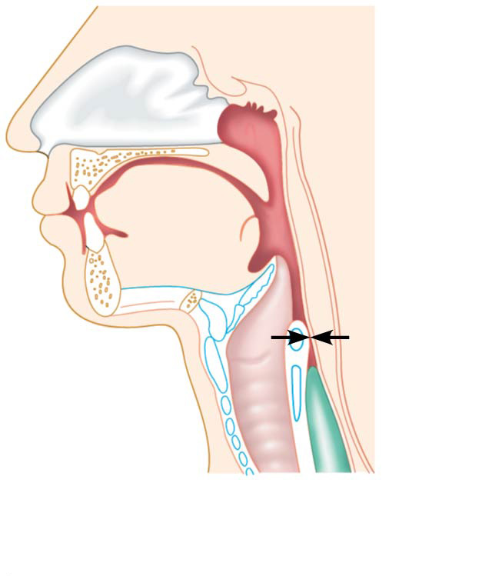
Figure 14.14c Swallowing.
Bolus
(c)
Upper esophageal
sphincter contracted

Slide 58
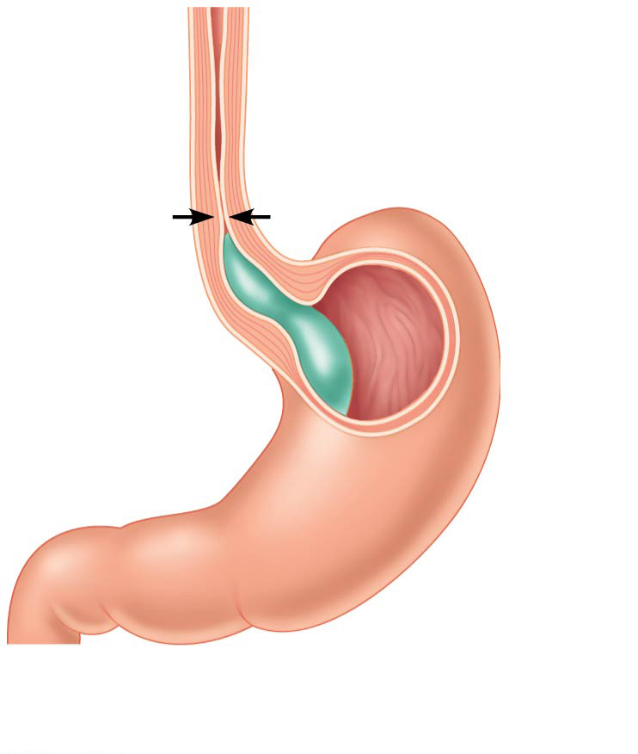
Figure 14.14d Swallowing.
Relaxed muscles
Cardioesophageal
sphincter open
(d)
Cardioesophageal
sphincter relaxed

Slide 59
Activities in the Stomach
Food breakdown
Gastric juice is regulated by neural and hormonal factors
Presence of food or rising pH causes the release of the hormone gastrin
Gastrin causes stomach glands to produce:
Protein-digesting enzymes
Mucus
Hydrochloric acid

Slide 60
Activities in the Stomach
Food breakdown (continued)
Hydrochloric acid makes the stomach contents very acidic
Acidic pH
Activates pepsinogen to pepsin for protein digestion
Provides a hostile environment for microorganisms

Slide 61
Activities in the Stomach
Food breakdown (continued)
Protein digestion enzymes
Pepsin—an active protein-digesting enzyme
Rennin—works on digesting milk protein in infants, not adults
Alcohol and aspirin are virtually the only items absorbed in the stomach

Slide 62
Activities in the Stomach
Food propulsion
Peristalsis: Waves of peristalsis occur from the fundus to the pylorus, forcing food past the pyloric sphincter
Grinding: The pylorus meters out chyme into the small intestine (3 ml at a time)
Retropulsion: Peristaltic waves close the pyloric sphincter, forcing content back into the stomach. The stomach empties in 4–6 hours

Slide 63
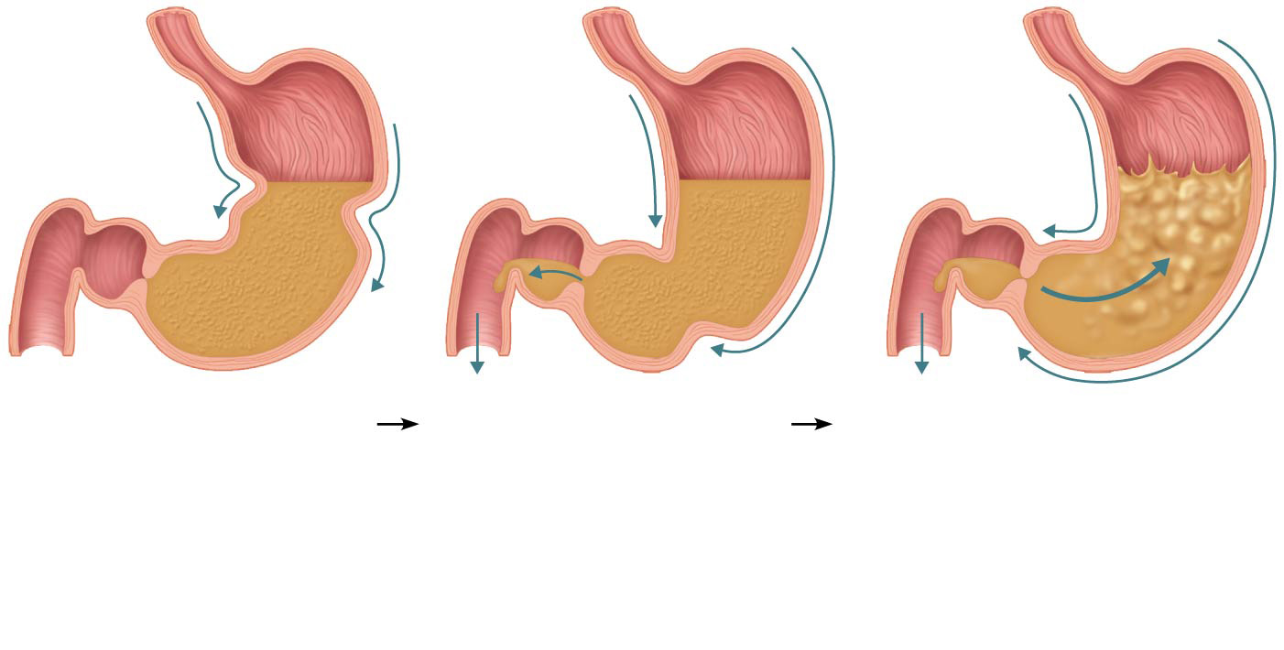
Figure 14.15 Peristaltic waves in the stomach.
Pyloric
valve
closed
Pyloric
valve
slightly
opened
Pyloric
valve
closed
1
2
3
Propulsion: Peristaltic
waves move from the
fundus toward the pylorus.
Grinding: The most
vigorous peristalsis and
mixing action occur close to
the pylorus. The pyloric end
of the stomach acts as a
pump that delivers small
amounts of chyme into the
duodenum.
Retropulsion: The
peristaltic wave closes the
pyloric valve, forcing most of
the contents of the pylorus
backward into the stomach.

Slide 64
Activities of the Small Intestine
Food breakdown and absorption
Intestinal enzymes from the brush border function to:
Break double sugars into simple sugars
Complete some protein digestion
Intestinal enzymes and pancreatic enzymes help to complete digestion of all food groups

Slide 65
Activities of the Small Intestine
Food breakdown and absorption (continued)
Pancreatic enzymes play the major role in the digestion of fats, proteins, and carbohydrates
Alkaline content neutralizes acidic chyme and provides the proper environment for the pancreatic enzymes to operate

Slide 66
Activities of the Small Intestine
Food breakdown and absorption (continued)
Release of pancreatic juice from the pancreas into the duodenum is stimulated by:
Vagus nerves
Local hormones that travel via the blood to influence the release of pancreatic juice (and bile):
Secretin
Cholecystokinin (CCK)

Slide 67
Activities of the Small Intestine
Food breakdown and absorption (continued)
Hormones (secretin and CCK) also target the liver and gallbladder to release bile
Bile
Acts as a fat emulsifier
Needed for fat absorption and absorption of fat-soluble vitamins (K, D, E, and A)

Slide 68
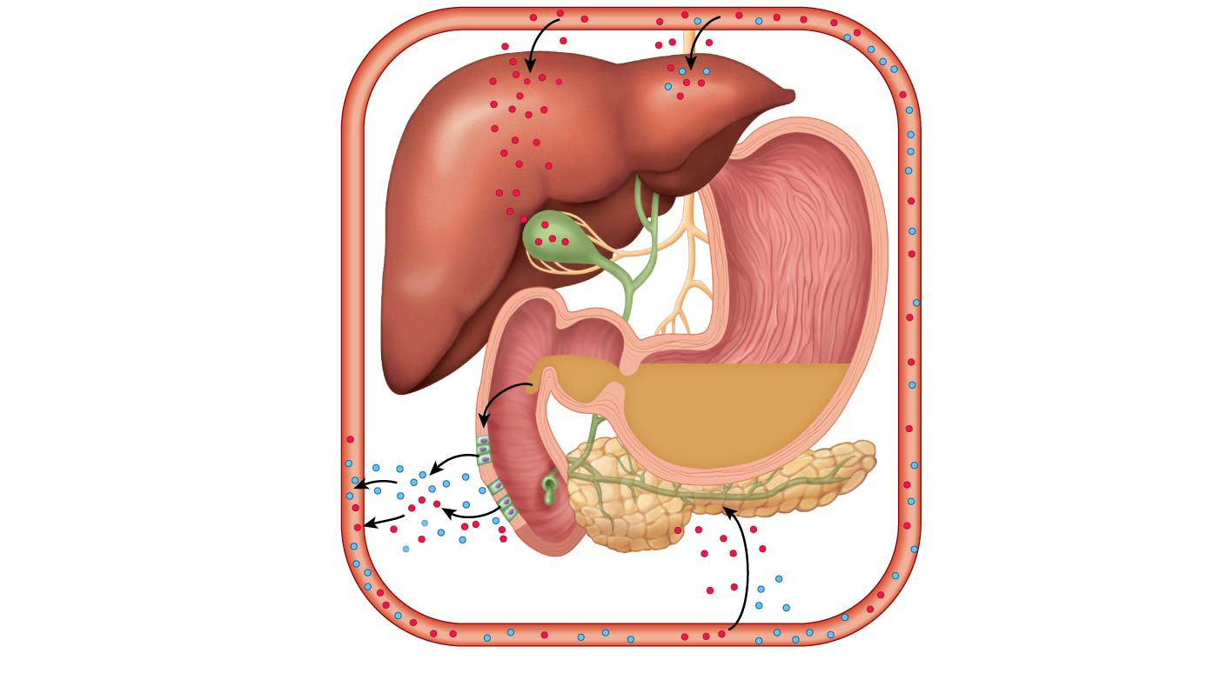
Figure 14.16 Regulation of pancreatic juice and bile secretion and release.
Secretin causes
the liver to secrete
more bile; CCK
stimulates the
gallbladder to
release stored bile
and the hepato-
pancreatic sphincter
to relax (allows bile
from both sources to
enter the duodenum).
4
Chyme entering
duodenum causes
duodenal entero-
endocrine cells to
release cholecytokinin
(CCK) and secretin.
1
CCK (red dots) and
secretin (blue dots)
enter the bloodstream.
2
5
Stimulation by
vagal nerve fibers
cause release of
pancreatic juice and
weak contractions of
the gallbladder.
Upon reaching the
pancreas, CCK induces
secretion of enzyme-rich
pancreatic juice; secretin
causes secretion of
bicarbonate-rich
pancreatic juice.
3

Slide 69
Activities of the Small Intestine
Food breakdown and absorption (continued)
Water is absorbed along the length of the small intestine
End products of digestion
Most substances are absorbed by active transport through cell membranes
Lipids are absorbed by diffusion
Substances are transported to the liver by the hepatic portal vein or lymph

Slide 70
Activities of the Small Intestine
Food breakdown and absorption
Peristalsis is the major means of moving food
Segmental movements
Mix chyme with digestive juices
Aid in propelling food

Slide 71
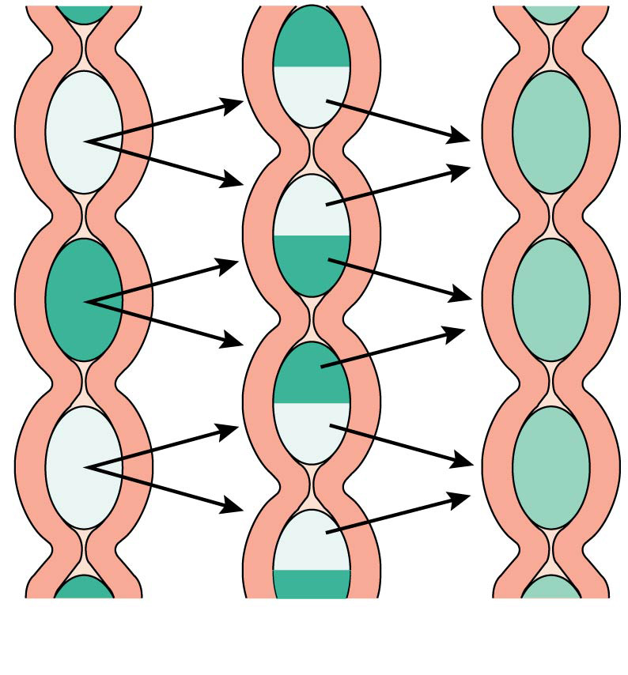
Figure 14.12b Peristaltic and segmental movements of the digestive tract.
(b)

Slide 72
Activities of the Large Intestine
Food breakdown and absorption
No digestive enzymes are produced
Resident bacteria digest remaining nutrients
Produce some vitamin K and B
Release gases
Water and vitamins K and B are absorbed
Remaining materials are eliminated via feces

Slide 73
Activities of the Large Intestine
Food breakdown and absorption (continued)
Feces contains:
Undigested food residues
Mucus
Bacteria
Water

Slide 74
Activities of the Large Intestine
Propulsion of the residue and defecation
Sluggish peristalsis begins when food residue arrives
Haustral contractions are most seen in the large intestine
Mass movements are slow, powerful movements that occur 3 to 4 times per day

Slide 75
Activities of the Large Intestine
Propulsion of the residue and defecation (continued)
Presence of feces in the rectum causes a defecation reflex
Internal anal sphincter is relaxed
Defecation occurs with relaxation of the voluntary (external) anal sphincter

