Slide 1


Lesson 1: Understanding Health & Wellness
Complete the sentence below:
When you have good health, you….

Slide 2
Think, Pair, Share Rules
You must talk with ONLY the person you’ve been instructed to talk with.
If no one is at your table, you must quickly turn either to the closest table in your row, or the table right behind you + make a group of 3.
You must discuss things related to the topic given (no outside discussions) AND try to answer all questions.
RESPECT your table partner’s thoughts and opinions (different than you doesn’t mean inferior to yours!!!)
Be a good listener and communicator.

Slide 3
Think, Pair, Share Rules
Define Health:
Define Wellness:
Describe in your own words the difference between health and wellness.
What lifestyle factors do you need to improve on?
If you were to pick one lifestyle factor to improve on, what would you do in order to achieve it?

Slide 4
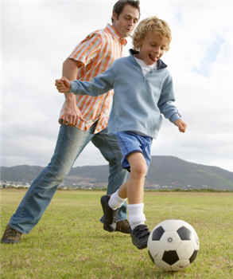
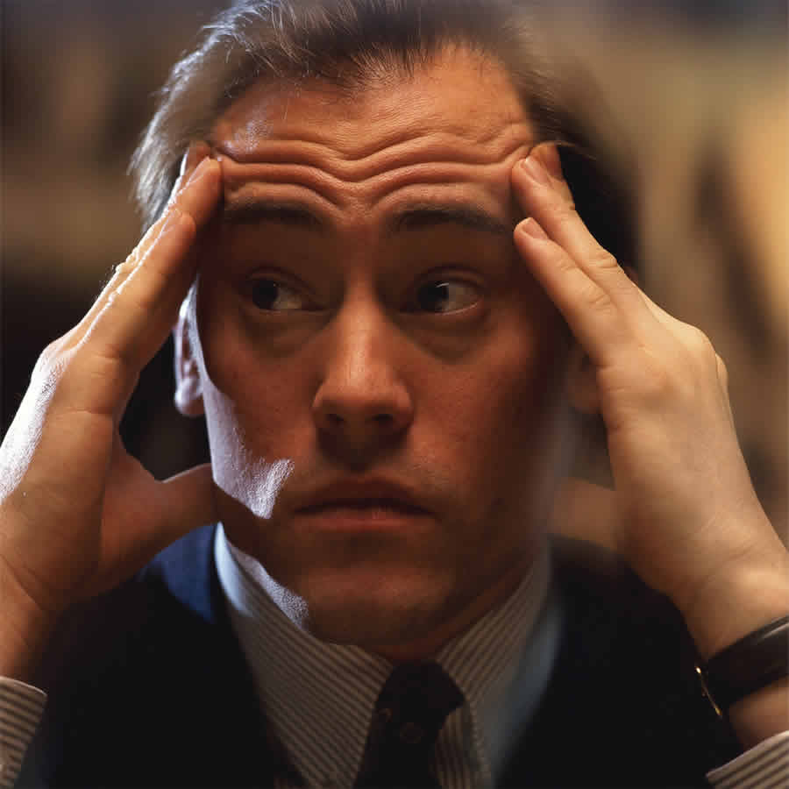

Defining Health
Health is/as
Multidimensional Wellness,
Holistic,
Continuum,
Dynamic,
Complex.

Slide 5

Concept # 1:Health is Multi-Dimensional
There are many different dimensions.

Slide 6
Concept # 1:Health is Multi-Dimensional
Get into groups of 4-5 students
Consider what behaviors or characteristics an individual might practice to enhance wellness within assigned dimension.
Questions to ponder: How might poor practice in one dimension impact another dimension. Include example.

Slide 7
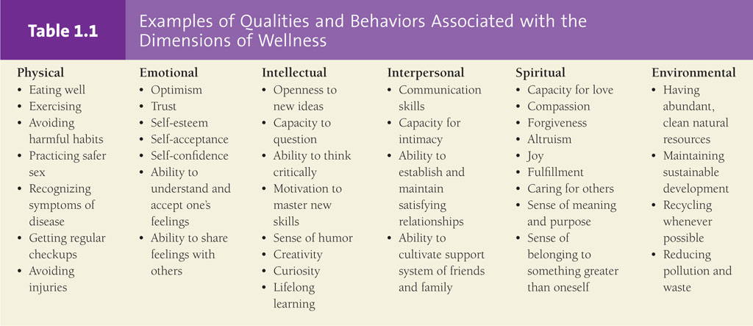


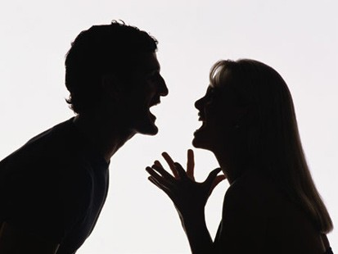
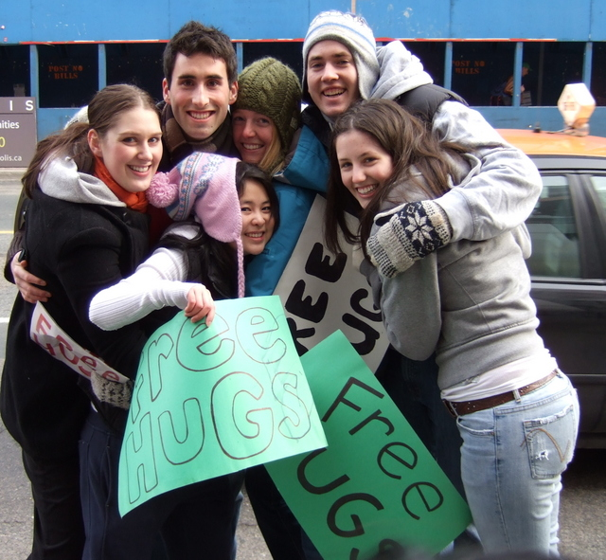

Concept # 1:Health is Multi-Dimensional

Slide 8
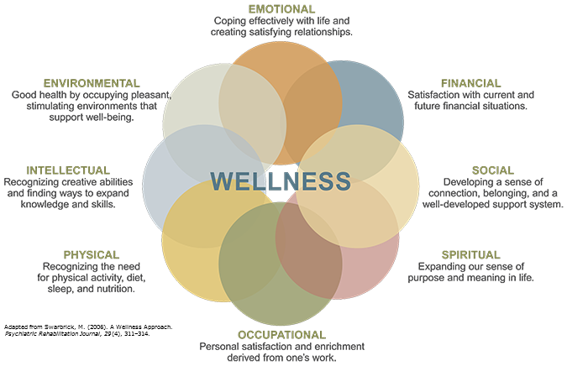
Concept # 2: Health is Holistic
The dimensions of heath are related.
They are NOT mutually exclusive
How does your...
Physical impact social?
Emotional/mental impact social?
Intellectual impact physical?

Slide 9
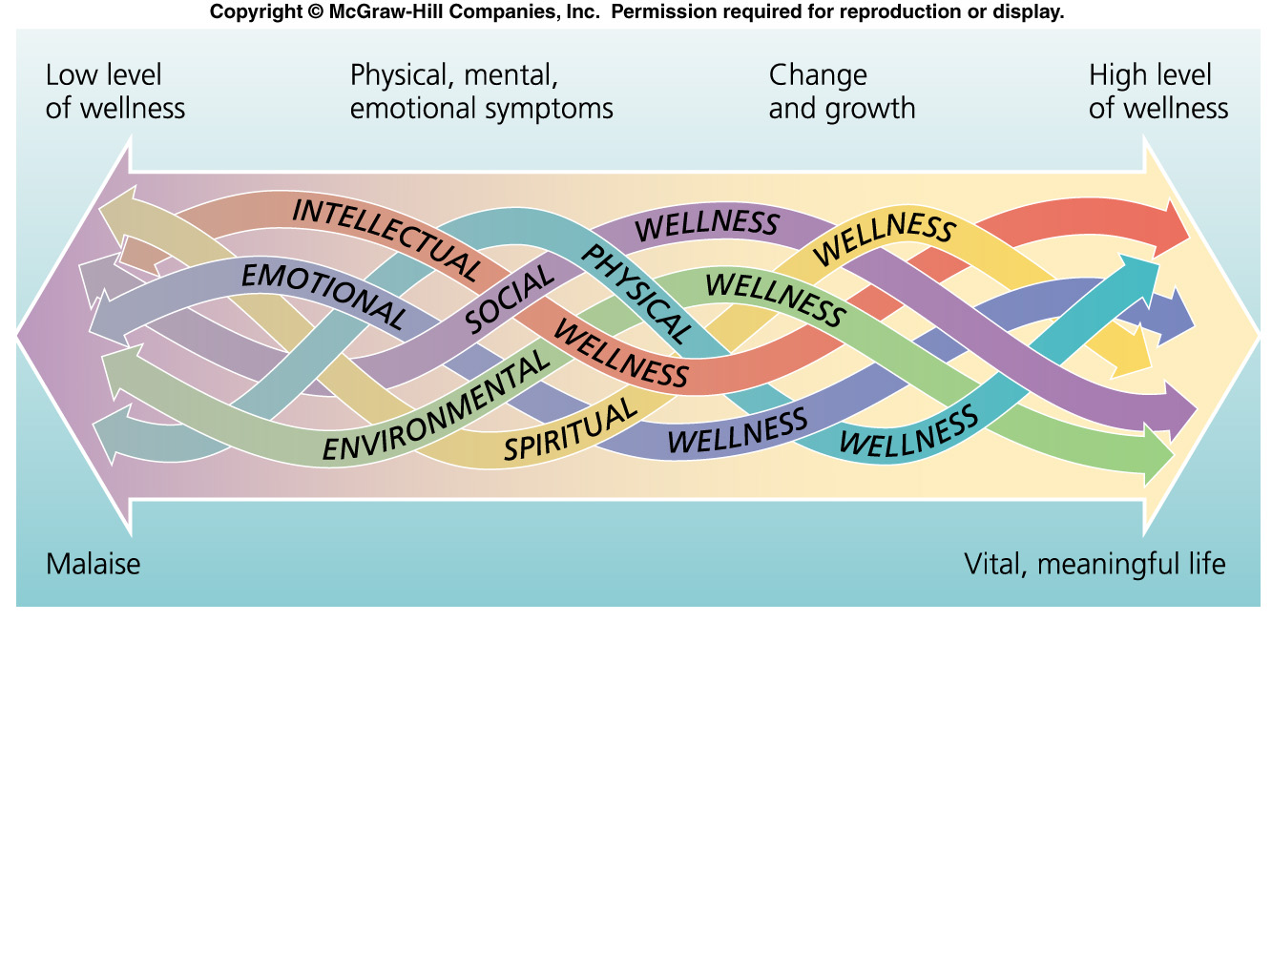
Concept # 3: Health as Continuum
A scale with a range of points used to measure wellness
Your location on the health continuum and the direction you are moving are both important.

Slide 10

Concept # 3: Health as Continuum
In class activity
In regards to the health continuum,
    Where are you right now?
    Where do you want to be a month from now?
    Where do you want to be a year from now?
Explain how being health literate can help you to achieve and maintain these health related goals.

Slide 11
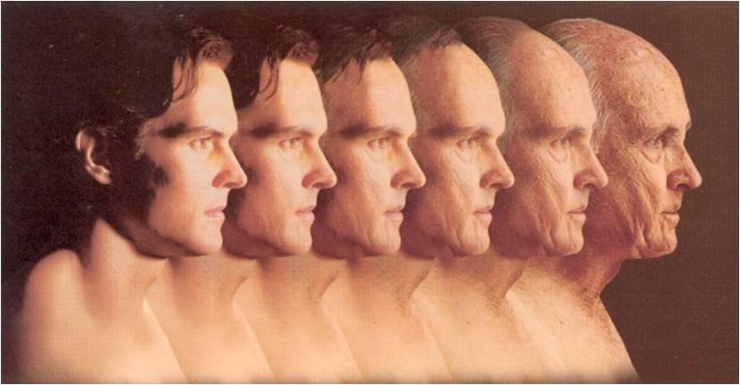
Concept # 4: Health is Dynamic
Always changing!
Fluctuating along the health continuum
Health is dynamic as our body and genetic predispositions interact with the psychological, social, cultural, spiritual, and physical environment

Slide 12

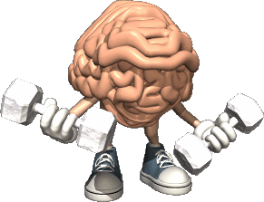
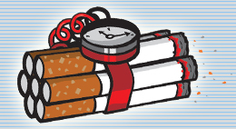

Concept # 5: Health is Complex
No simple explanation!
One proof that health is complex is...
Health Knowledge Health Behaviors
Why do we do things we know we shouldn't or don't do the things we know we should!

Slide 13
Health VS. Wellness
Health can be influenced by factors that are out of your control (genes, age, and family history).
  Example: A 60 year old man with a strong family history of prostate cancer place him at high risk for prostate cancer
Wellness is largely determined by decisions you make about how you live. That same individual can reduce his risk of cancer by eating sensibly, exercising, and having regular screening tests
Can someone who is "unhealthy" still achieve wellness?

Slide 14

The decisions you make every day effect your health and wellness.
Lifestyle Factors: The personal habits or behavior related to how a person lives.
Positive lifestyle factors include:
  Getting 8 –10 hours of sleep each night
  Starting each day with a healthy breakfast
  Maintaining a healthy weight
  Avoiding tobacco, alcohol, and other harmful drugs
  Abstaining from risky sexual behaviors
  Managing stress
  Practicing safe behaviors in all other areas

Slide 15

Importance of Health Science Education
Providing accurate health information and teaching health skills to help people make healthy decisions.

Slide 16
National Health Goals:
Health People 2020
4 broad goals:
Increase the quality and years of healthy life
Eliminate differences in health based on race, ethnic group, or income
Create social and physical environments that promote good health
Promote healthy behaviors, health development, and quality of life across all life stages
    Web site: http://www.cdc.gov/nchs/healthy_people/hp2020.htm

Slide 17
Think, Pair, Share Rules
What do you think you know about the following:
In 1900 the average life expectancy was 47 years old. Today it is about 78 years old. What has caused the steady increase in life expectancy from the beginning of the 19th century to today?
What do you think caused this jump in lifespan?

Slide 18

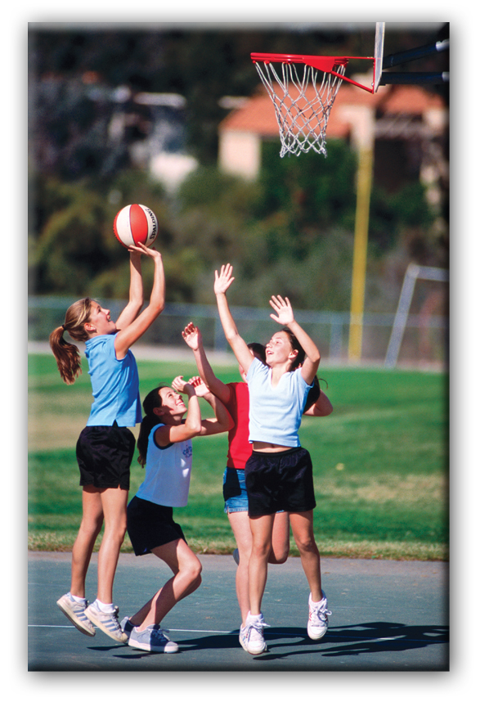
Influences on Health
Heredity & Gender
Physical Environment
Social environment
Culture
Attitude & Behavior
Media & Technology
Health Care

Slide 19
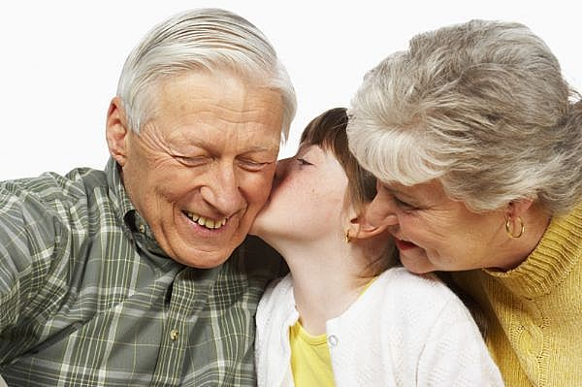
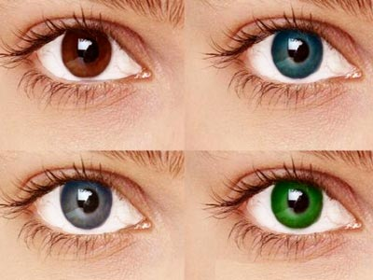
#1 – Heredity & Gender
Heredity refers to all the traits that were biologically passed on to you from your parents
Examples: Skin color (higher risk of skin cancer), hair color, eye color, body type, risks for heart disease, diabetes, breast cancer, etc.

Slide 20

#2 – Environment
Environment: the sum of all your surrounding
  Physical Environment: Neighborhood, school, air and water quality, recreational facilities, exposure to disease-causing organisms, to loud noise, radiation, etc.
  Social Environment: People around you; friends and family, peer pressure, bullies, etc.
  Culture: The collective beliefs, customs, and pattern of behaviors of a group passed on from generation to generation
The physical places in which you live.
The people who make up your world.
The culture you live in.

Slide 21
#3 – Attitude & Behavior
Attitude: The way you view things.
Behavior: The control we have over our actions.
“Attitude is the Father of behavior” – your attitude (mind set) determines your actions, and you choose you attitude, so CHOICE = CONTROL
Events + Thoughts = Feeling
Habit: behavior that is repeated so often that it becomes almost automatic

Slide 22
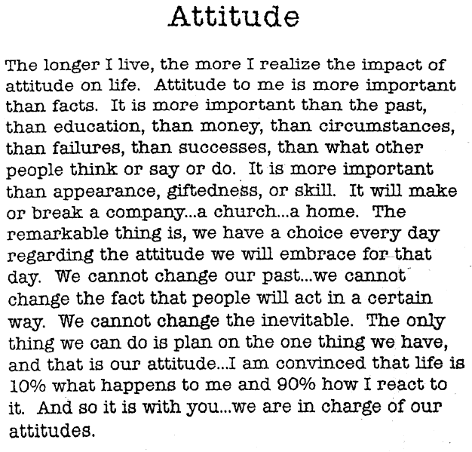
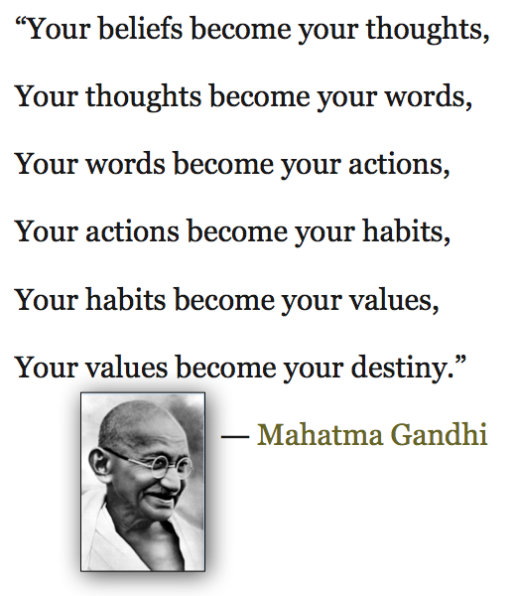

— Charles R. Swindoll

Slide 23




#4 – Media & Technology
Two most powerful influence on your health
Media: all forms of communication that provide news and entertainment
  Radio, television, and Internet
  Print; newspapers and magazines.
TV Personalities become role models
  Positive and Negative
  Models and Athletes

Slide 24


#5 – Healthcare
Healthcare include medical services provide by doctor, nurses, dentists, and therapists, and places such as hospital and clinics.
Availability, accessibility, and affordability of healthcare influence heath
  Health insurance, health emergencies, checkups, testing, treatments, medicine, etc.

Slide 25
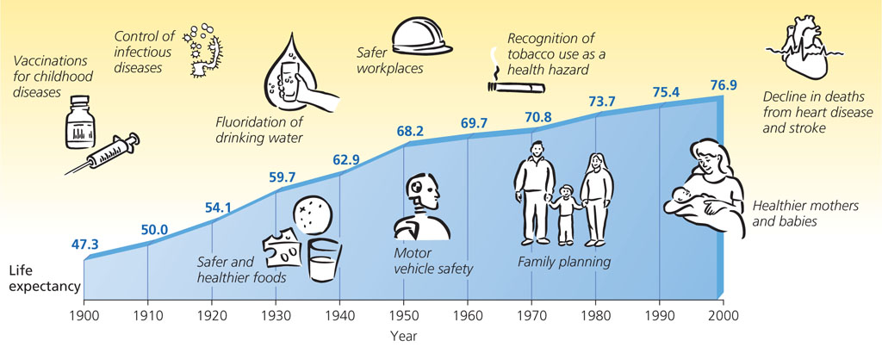
#5 – Healthcare

Slide 26


Evaluating Health Risks
Risk Factor include any action or condition that increases the likelihood of injury, disease, or other negative outcome.
We need to identify threats to our health so we can make safe and responsible decisions.
3 ways to evaluate health risk factor:
  Consider both short— and long— term consequences
  Decide whether you can and cannot control the risk factor
  Analyze the benefits and risks of a decision

Slide 27
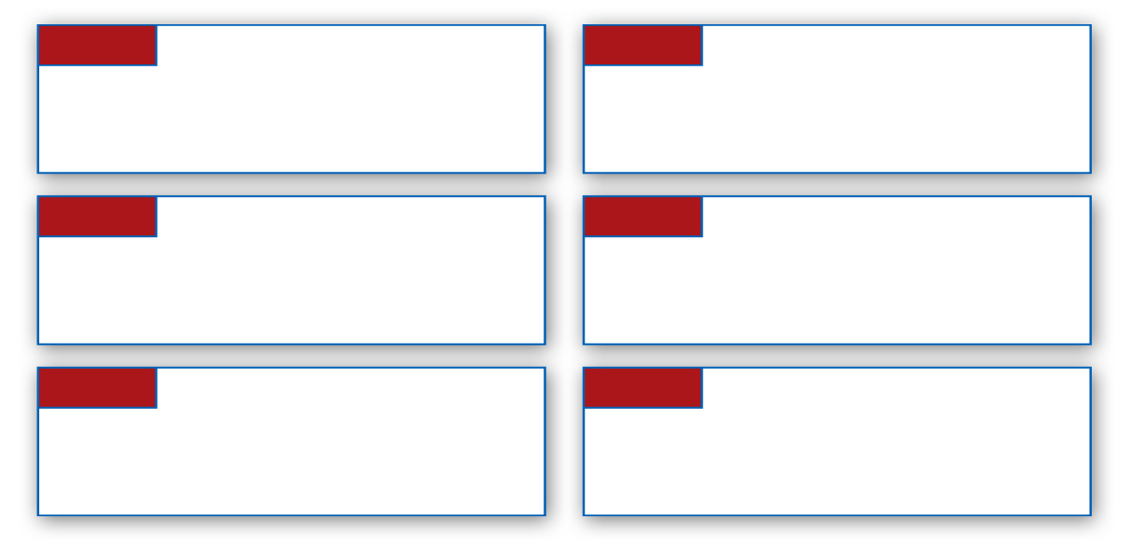
Recognizing Risk Behaviors
The Centers for Disease Control and Prevention (CDC) has identified six of the most significant risk behaviors for young people under age 24.
1
4
Tobacco use
Alcohol and other drug use
2
5
Unhealthy dietary behaviors
Sexual behaviors
3
6
Inadequate physical activity
Behaviors that contribute to injuries and violence

Slide 28

How to Avoid or Reduce Risks
Prevention: Taking steps to keep something from happening or getting worse.
Practicing healthy habits to keep a person well and free from disease and other ailments.
Ex. Seatbelts, sunscreen, wearing a helmet, getting regular check-ups.
Abstinence: A deliberate decision to avoid high-risk behaviors, including sexual activity, and the use of tobacco, alcohol, and other drugs.
1
4
2
5
3
6

Slide 29

Becoming Health Literate
To become an informed individual who can make sound health decisions, one must know how to:
Find health information
Decide if the information is correct
Assess the risks and benefits of treatment
Figure out how much medicine to take
Understand test results

Slide 30





Health Literacy
Health Literacy- Refers to a person’s capacity to learn about and understand basic health information and services to use these resources to promote one’s health and wellness.

Slide 31
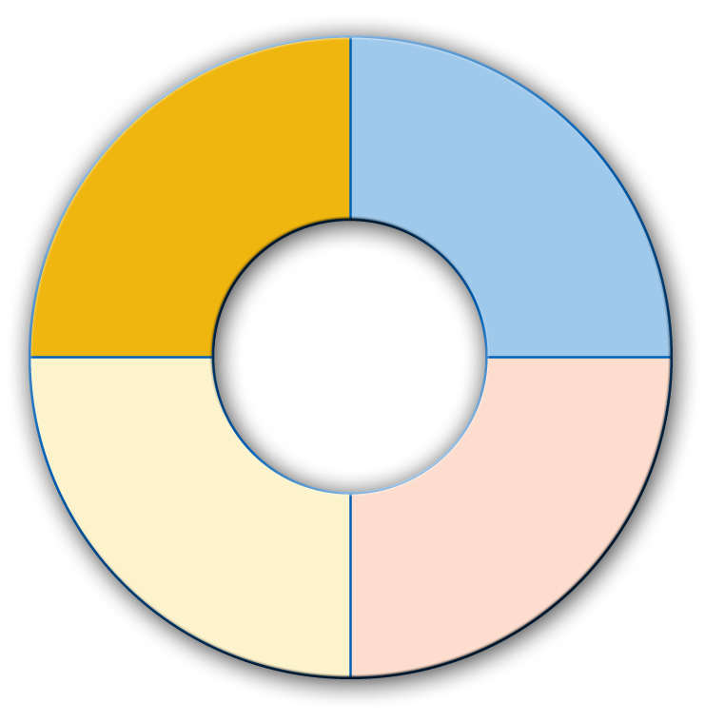
What can I do?
a critical thinker and problem solver
a responsible, productive citizen
Qualities of a Health-Literate Individual
a self-directed learner
an effective communicator

